Slide 1
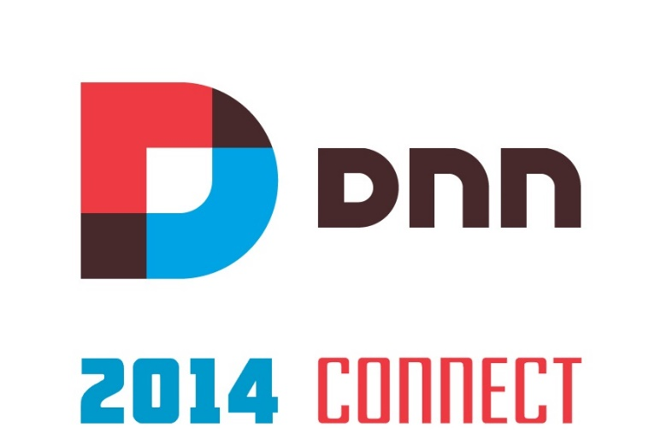
Building an MVP App with DNN Sharp Modules
Bogdan Litescu
@DNN Sharp
Over 2000 Customers Sold And Supported Since 2009…
Our Reputation Is Our Most Valuable Asset

Slide 2
DNN Sweetspot?
DNN / DotNetNuke – a State of the CMS Report 2013
Small Biz Website (27.2%)
Public Enterprise Websites (18.5%)
Web Applications (19.3%)

Slide 3
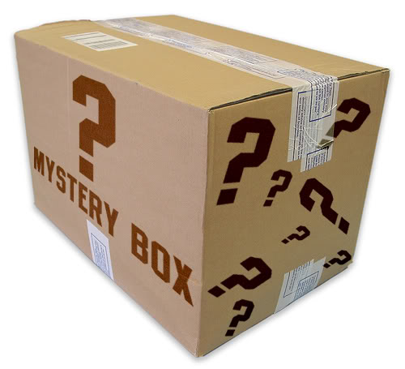
Web App Development Platform You Said?!

Slide 4
DNN?

Slide 5
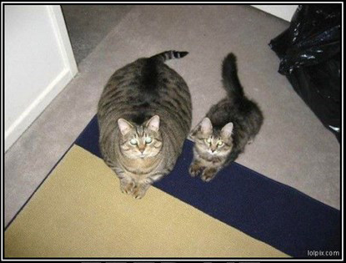
DNN?
High Resources Consumption
FEED ME!
…or I eat the little one

Slide 6
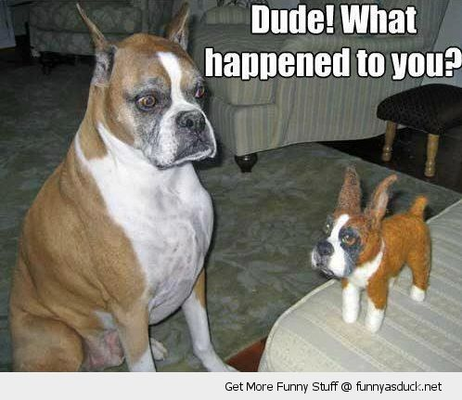
A Light DNN Version

Slide 7
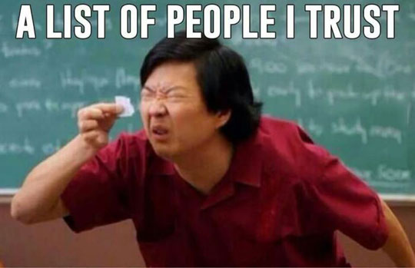
DNN?
Small Community

Slide 8
DNN?
Vendors go out of business

Slide 9
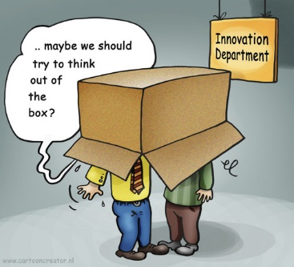
Today’s Goal
Think Outside the Box!

Slide 10
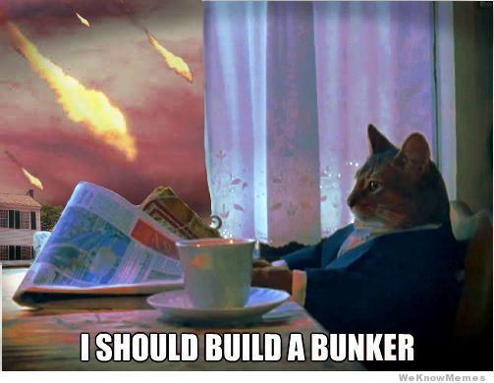
Build Competitive Solutions in The Real World

Slide 11
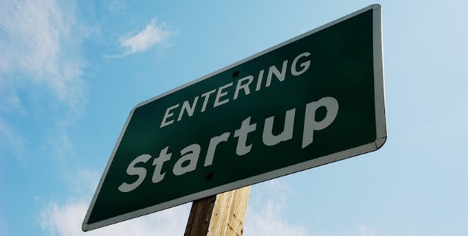
What is the scenario where all the above doesn’t matter?
MVPs!

Slide 12
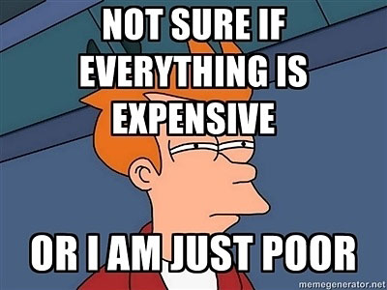
Time and Costs

Slide 13
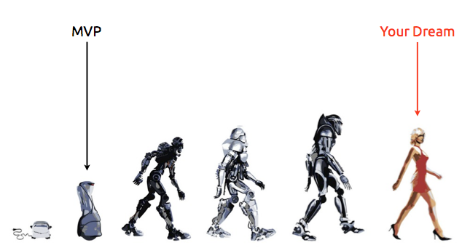
…it’s a strategy, not a product

Slide 14
MVP Demo

