Slide 1

Quick Survey
https://forms.office.com/r/daPLumuMeK
Notes:
Survey:
Template go-to ?
DAL, DAL+, DAL2, EntityFramework, Dapper, etc.\
Dependency injection usage
Unit Tests
Integration Tests
Documentation
CI/CD
GitVersion
Results are at https://forms.office.com/Pages/AnalysisPage.aspx?AnalyzerToken=vSQkkxWYeDPYv7ug9oWgzAKbvYQ85nln&id=DQSIkWdsW0yxEjajBLZtrQAAAAAAAAAAAAN__oBsoCZUOE5KTkhGV1lZUTNGMVBUUFVaQzZMMFNPVi4u

Slide 2


Slide 3







Dnn User since Dnn 4
Custom theme development
Custom module development
  @valadas
  @danielvaladas
Member of the Dnn Technology Advisory group
Team lead for the Core Modules developers group
  @valadas_daniel
  dvaladas.slack.com
  Daniel Valadas#9381
  info@danielvaladas.com
Daniel Valadas
Notes:
Welcome
This is me

Slide 4


Questions are welcome during the presentation
Notes:
Questions are welcome during the presentation

Slide 5
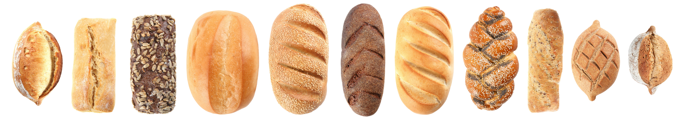



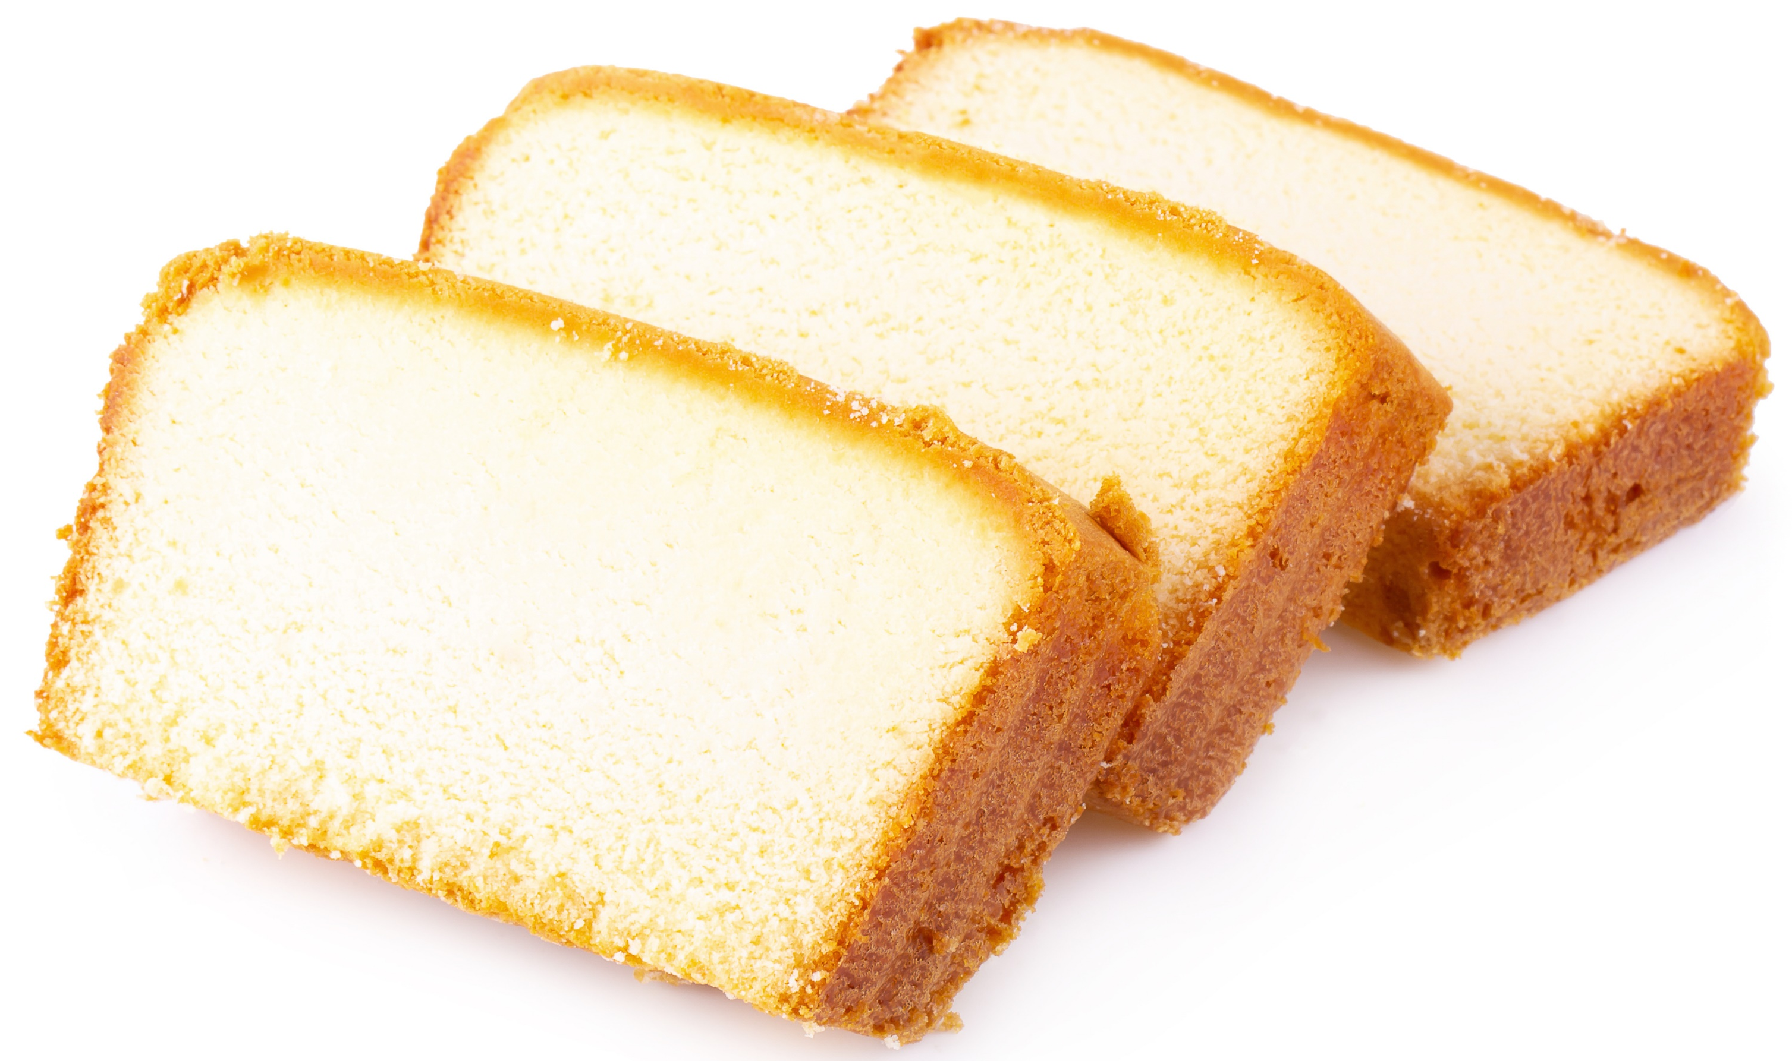





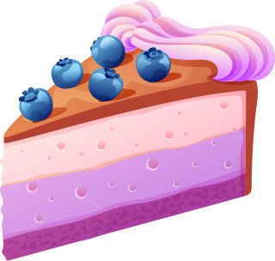
Flour + Water (66-100%) + Heat (350°F - 475°F / 180°C - 250°C) for 10-45 minutes.
Add sugar and eggs
+
Other
Stuff
Baking 101
Notes:
If you try to make a nice fancy cake, you don`t start guessing everything, you start from some basics like bread and a basic cake and expand on some principles to make your advanced cake.
Templates in anything are a spectrum. This template is not the basic kind.
It is the fancy cake with the cherry on top. It is not for beginners and is somehow opiniated.
But it lets you hit the ground running.

Slide 6

Build it and they will come
Real C# console application in .Net (super easy to debug, extend)
Type safe (not a single magic string)
Cross-platform (build on windows, mac, linux)
On Github Actions, ubuntu build 4x faster than windows and costs 8x less minutes
Uses Nuke https://nuke.build to bring fluent APIs over popular .Net tools
Built-in auto-generation of popular CI platforms (no more writing yaml)!
Build targets directly available in VisualStudio (F5 Experience)
Support for secrets management (API keys and such)
Build is versioned with the rest of your code (vs defined in CI).
Build / Packaging
Notes:
Nuke.build
Sponsor Mathias at https://nuke.build he really deserves it.

Slide 7

Automated build/release
Once pushed to a remote, more build features kick in
Automatic Versioning happens
Automatic CI builds happen
Automatic Releases are created
Automatic Release Notes get done for you
Dependabot pre-configured
Mergeable pre-configured (enforces milestone and label for release notes)
Made for Git / Github
Notes:
Because of new github permissions, the first build will fail and you need to go to the settings and change actions settings to allow read/write

Slide 8

DocFx
Template documentation provided
Add any articles you want (ex: for customer docs)
Backend code APIs by source code comments (enforced)
Swagger (Rest APIs auto-generated
WebComponents documentation auto-generated
Documentation support
Notes:
Code is like humour, if you have to explain it, it's bad.
API documentation is developer UX

Slide 9
WebComponents
HTML module pipeline (SPA)
Lightweight
Typescript enforced
W3C Compliant
No framework involved (build-time only compiler)
Frontend
Notes:
See my other presentation specific to web components

Slide 10
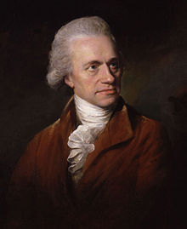
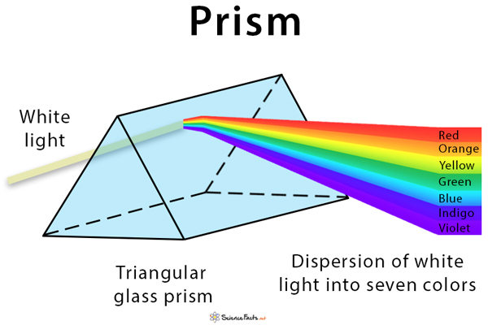



William Herschel
Unit Testing
Notes:
William Herschel was an astronomer. He tried different color filters in telescopes to try and see the sky differently.
He noticed that different color filters had different temperatures after use.
He formulated a theory (you gonna see this term used in UnitTests often), the theory was that different colored light had different temperatures.
To prove or disprove his theory he put a glass prism to separate white light into the color spectrum and placed a thermometer under the light of each color.
As with any scientific method you always need some control tests (test that are outside the theory). So he placed a thermometer on each side outside the light.
To his big surprise, the thermometer just after the red color was way hotter than any other even though it was not under any visible light.
He just discovered infrared light.
Moral of the story, tests allow you to discover unthinkable effects (bugs), to think and test the "unhappy path" which developers never think about.

Slide 11
TDD Why? It's a discipline.
Think about the "Unhappy" path (what could possibly go wrong)
Let the architecture come to you: decoupled, modal design (DI)
Destroy unreachable code
Identify breaking changes
Refactor with confidence
Save time !!!
  The only way to go fast is to go right
  QA: Identifies bugs early in the project, saves time later
  Simpler debugging, don't need a site running
  Developer documentation (live examples for new devs on the project)
  Test everything on every build (CI/CD integration)
Why Unit Tests

Slide 12

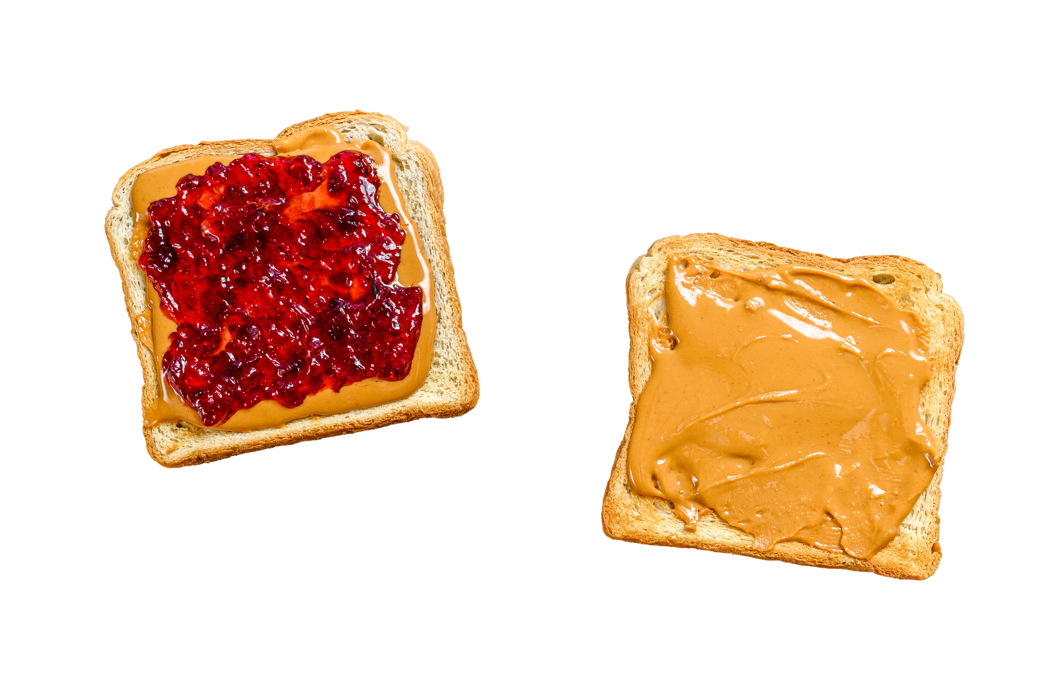
Unit Tests
Integration Tests
Unit Tests vs Integration Tests
Notes:
If you develop a new jam, you can unit test it and be pretty satisfied it is good. You test the jam, the peanut butter and the bread and you have a pretty good idea that a PB&J sandwich will taste good with your new jam.
For most complex stuff like a cake, you can taste a raw egg and it will be pretty disguting but you see the egg is ok, you can test the milk is not sour, you can try testing the flour tastes ok, etc. But you have no idea if the cake will be good. For that you need to taste the whole cake. This is what integration tests are.
- Turn bug reports into change requests.: If you build proper integration tests as per requirements and something is wrong. It is a change request and not a bug. It was designed exactly that way and your test is not failing.
- Regression testing: If any integration test breaks unexpectedly on a build, you just found a regression bug. It was working fine just before this change.

Slide 13
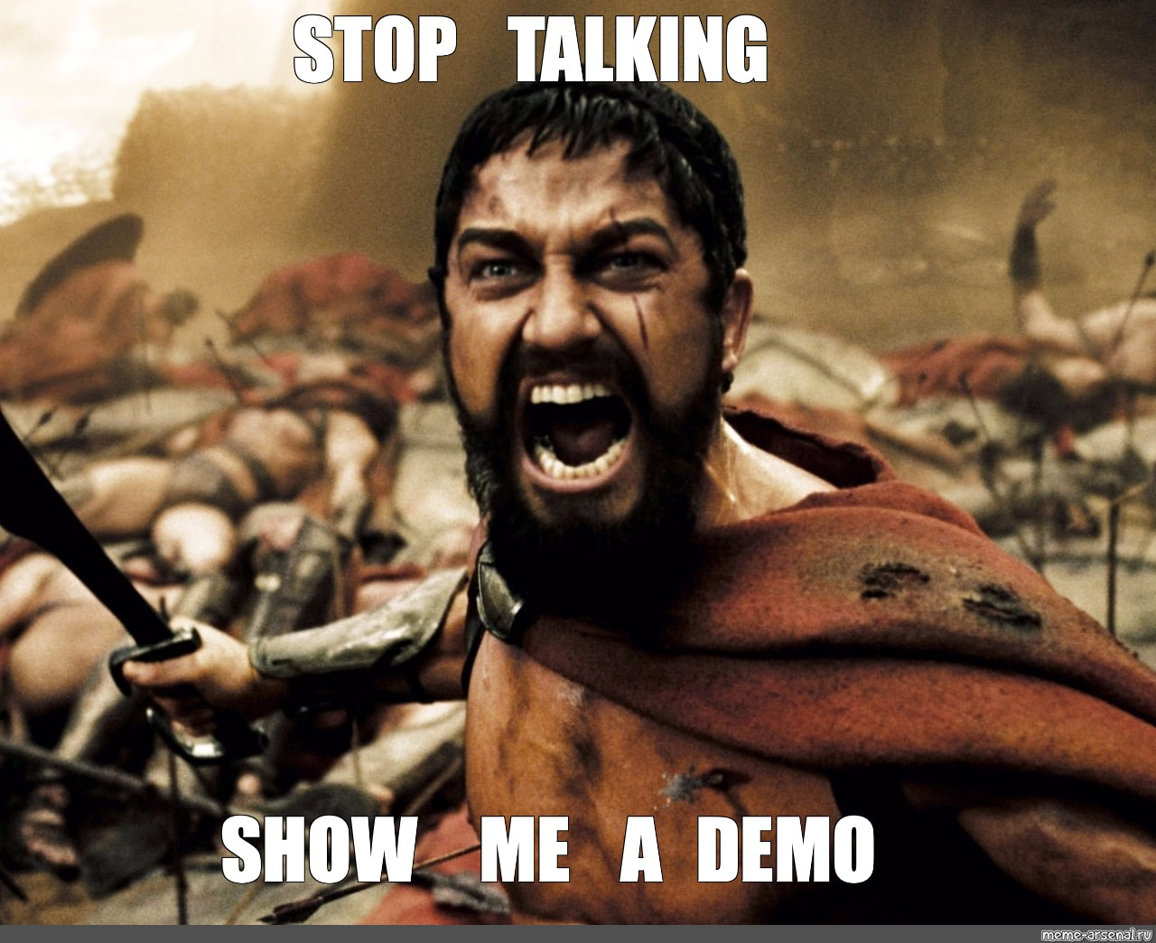
DEMO TIME
Notes:
Demo Time!
Template is available here: https://marketplace.visualstudio.com/items?itemName=DanielValadas.eraware-dnn-templates and you can also search for "Eraware" directly in Visual Studio extensions menu
Repository is here: https://github.com/valadas/Eraware_Dnn_Templates
Contributions and Sponsorships are welcome: https://github.com/sponsors/valadas

Slide 14
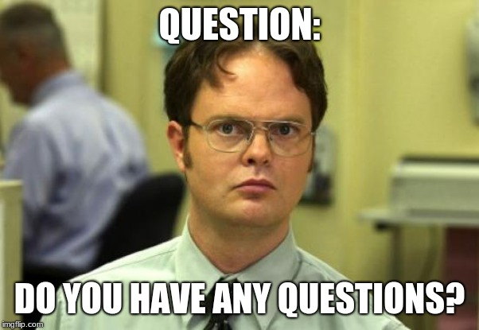
Q&A
Notes:
Questions ?

