Slide 1
DNN Connect 2014
Ignite session
Ernst Peter Tamminga

Slide 2
I want your money

Slide 3
I want your money
But not for myself

Slide 4
I want your money
But not for myself
And you will get it back

Slide 5
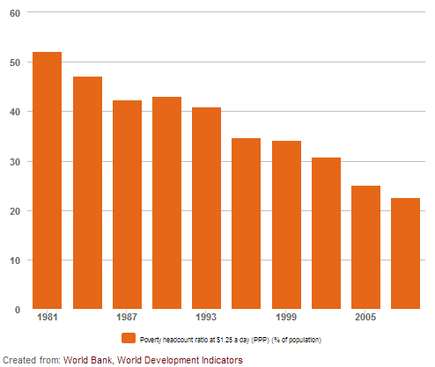
Do you know the percentage of people living on less than $1,25 a day?

Slide 6
Do you know the percentage of people living on less than $1 a day?
At least 80% of humanity lives on less than $10 a day

Slide 7
www.kiva.org

Slide 8
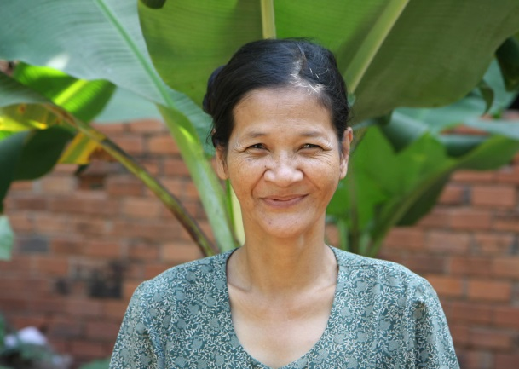
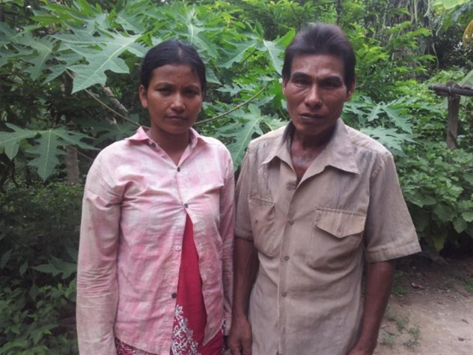
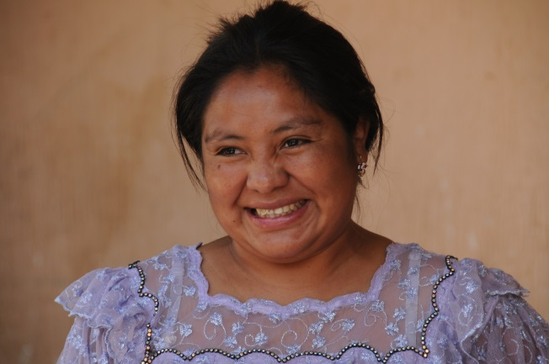
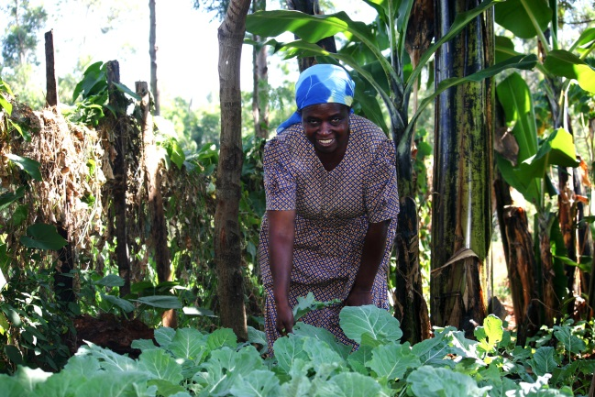
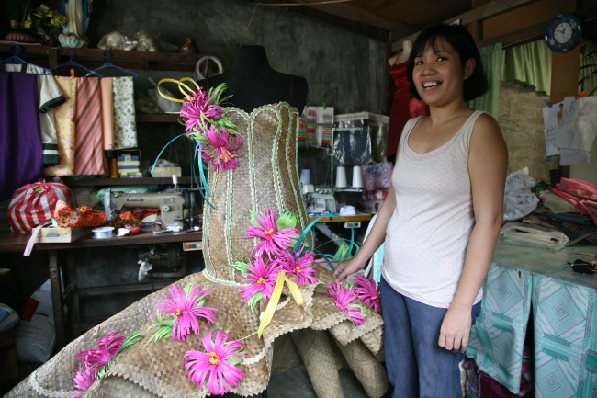
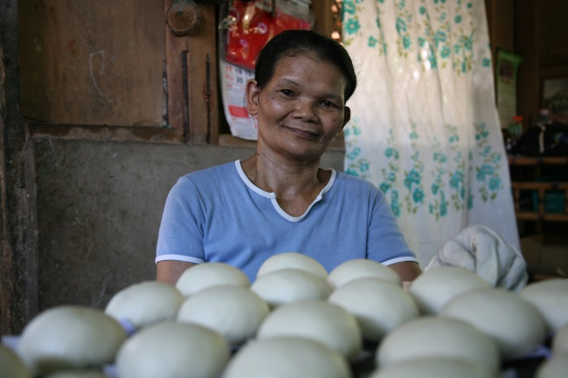
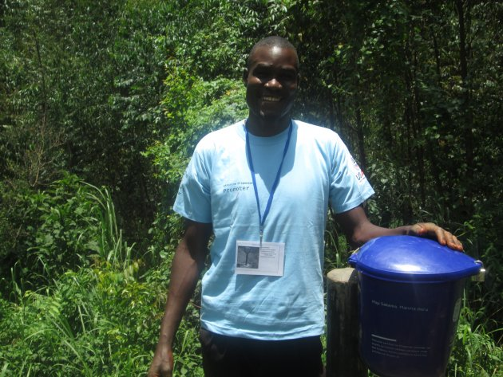
KIVA Provided loans for more than 1,000,000 people around the world, 80% women

Slide 9
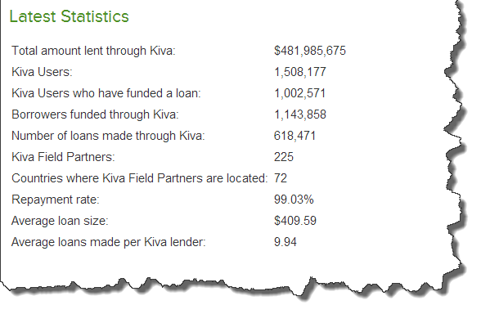
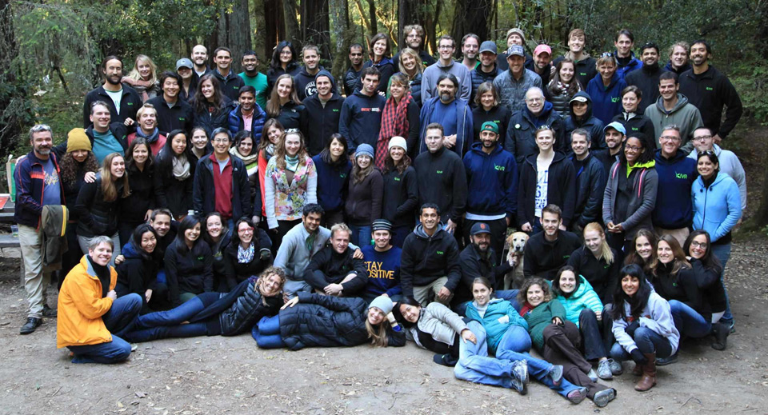
What is KIVA?
Started April 2004

Slide 10
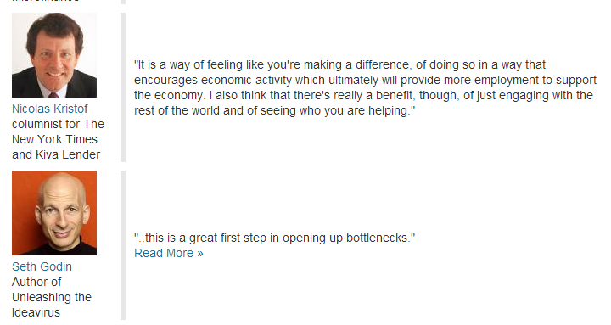
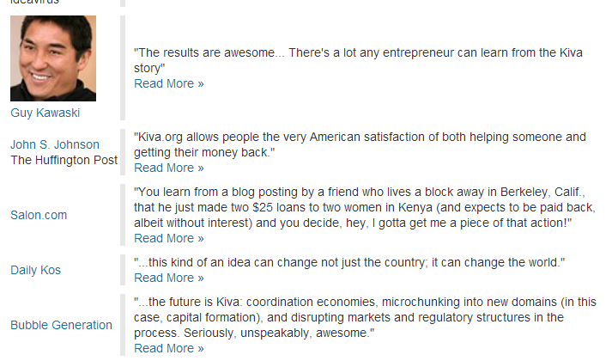
KIVA is supported by well know people

Slide 11
www.kiva.org

Slide 12
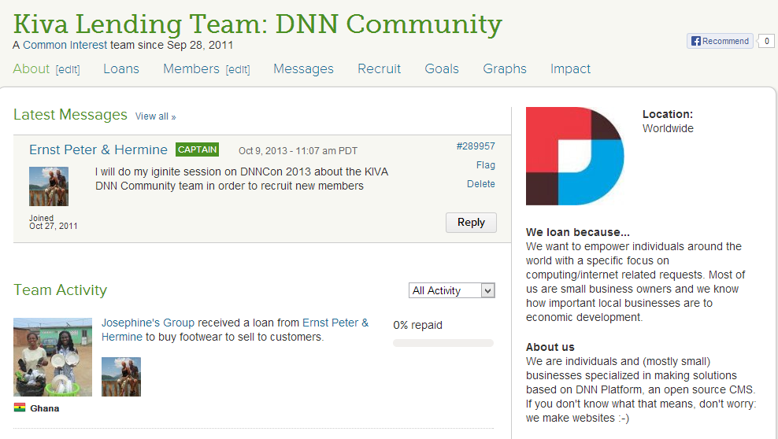
DNN Community has formed a lending team on KIVA.org

Slide 13
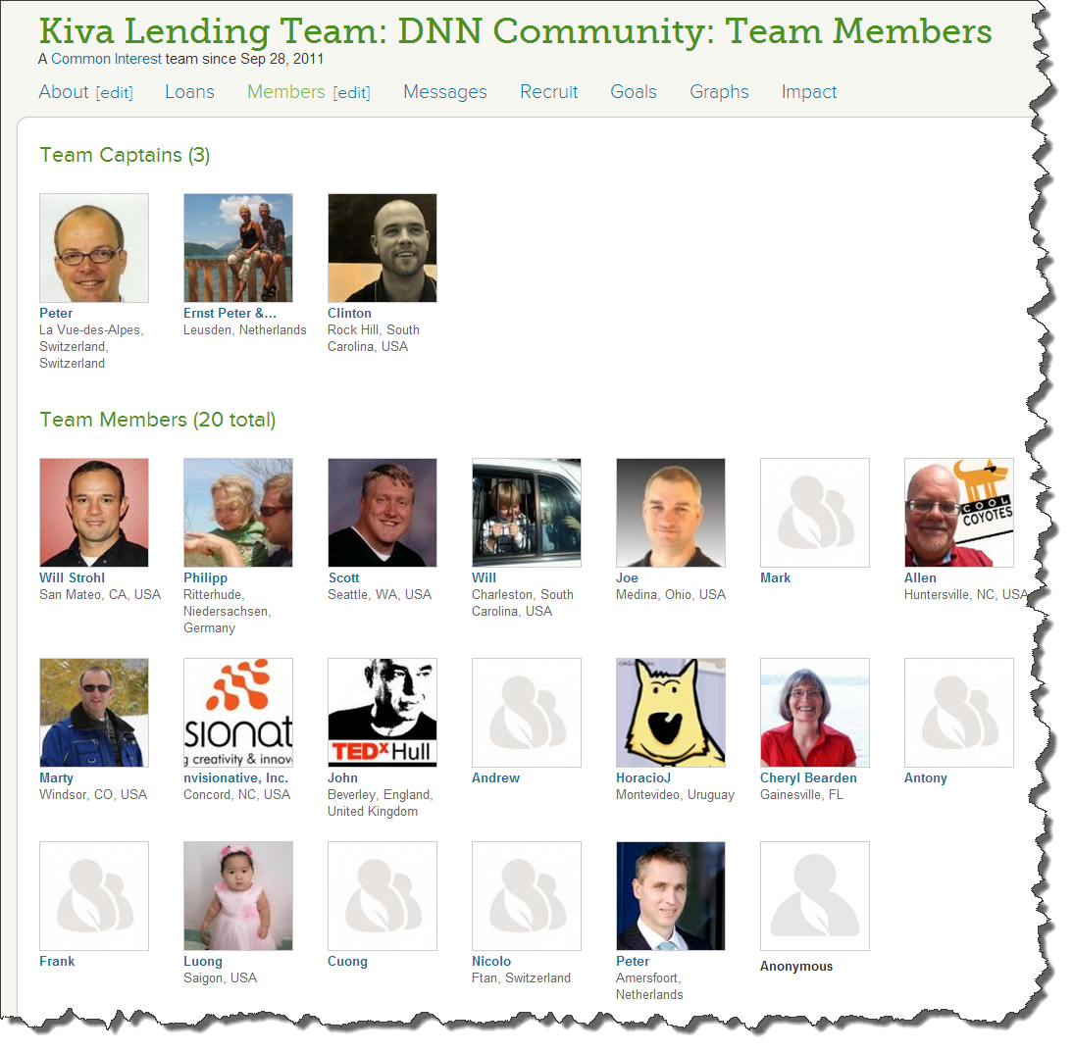
Well know and less well know DNN community members form the open DNN Community team on KIVA.org

Slide 14
Well know and less well know DNN community members form the open DNN Community team on KIVA.org
You can must join the team!

Slide 15
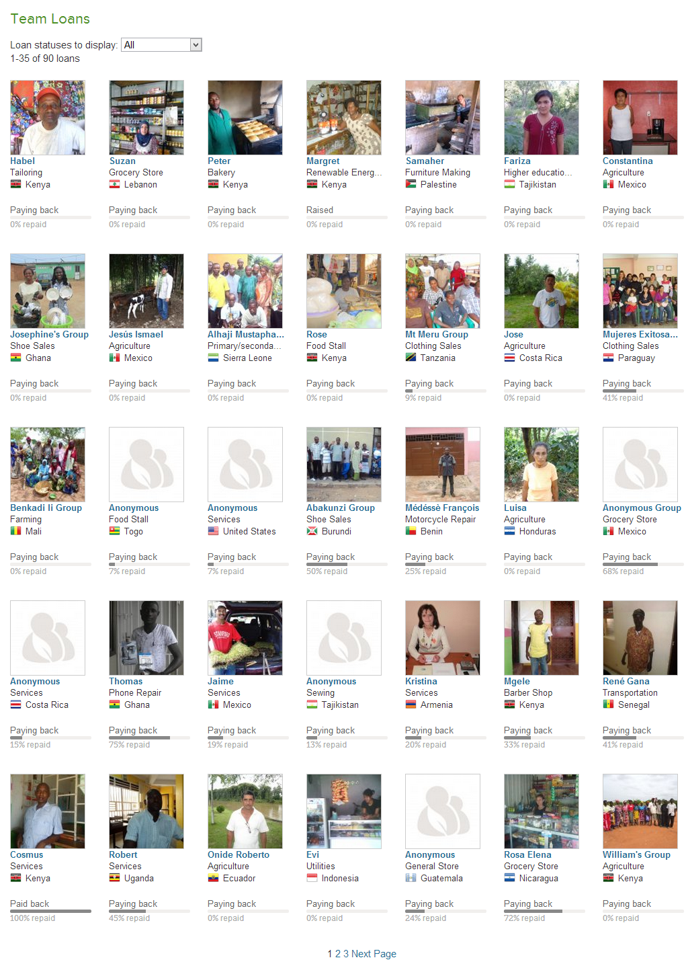
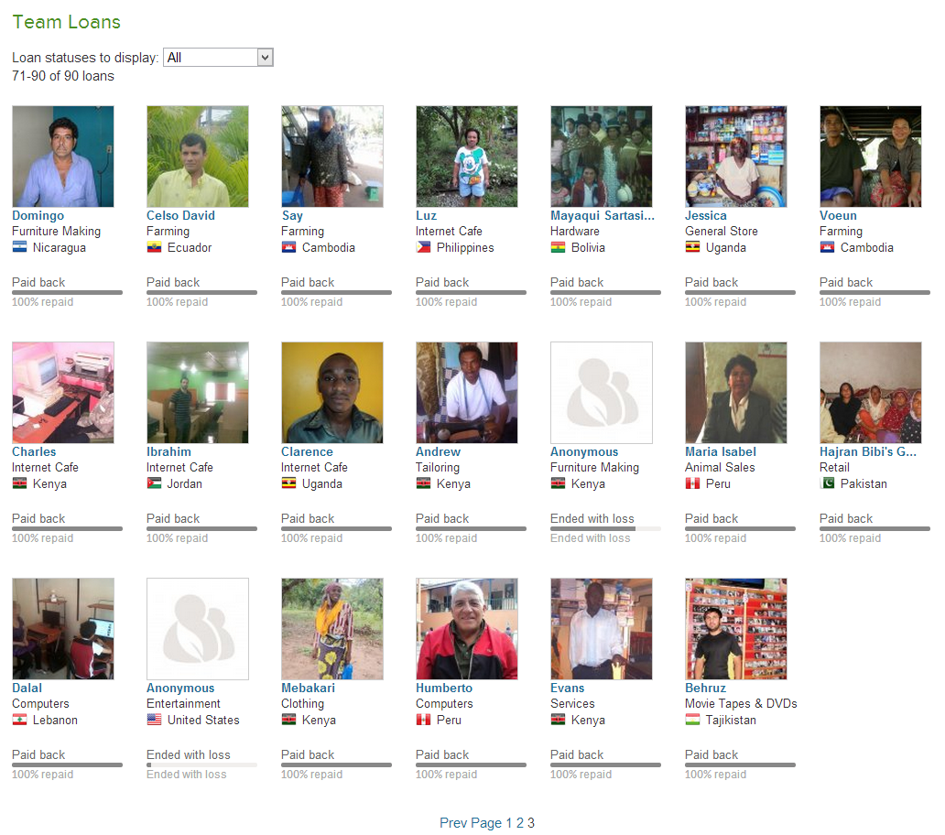
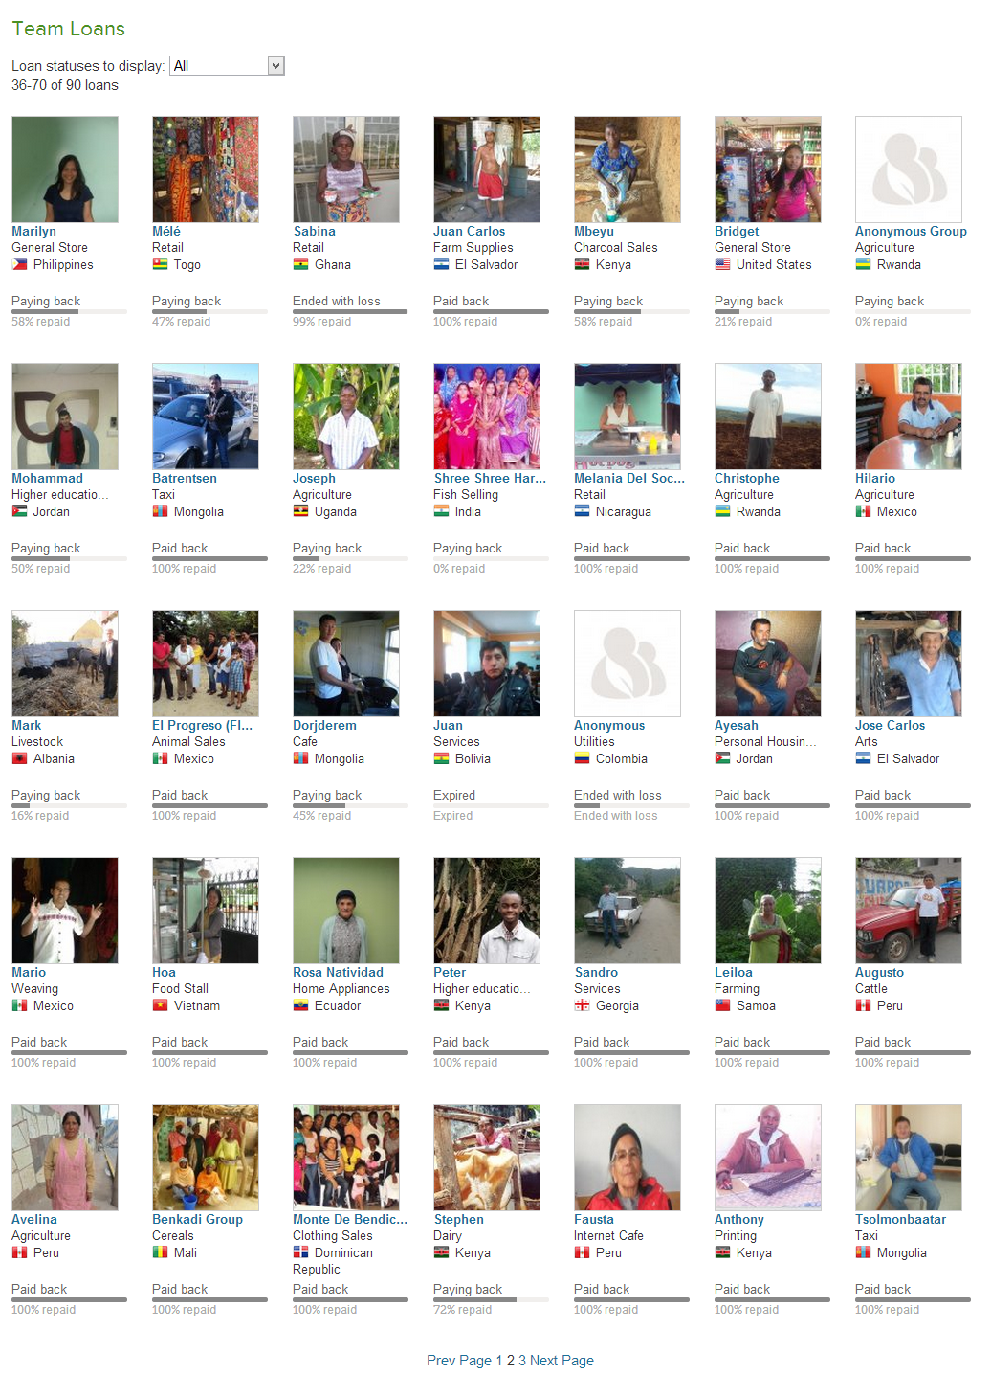

Slide 16
The DNN Community team on KIVA made a number of loans, but there is room for more!

Slide 17
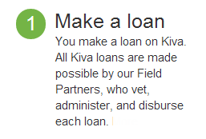
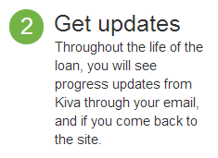
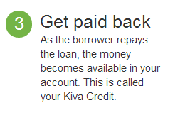
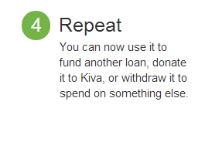
How does it work?
Put $25 into your account

Slide 18
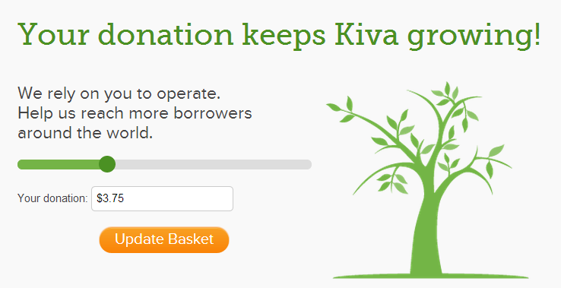
Who pays the bill?
Your exta donation may vary (and can be $0)

Slide 19
Can I loose my
money ($25)?

Slide 20
Can I loose my
money ($25)?
Yes, there is a small chance (<1%) that the loan is not fully paid back

Slide 21
How can I start with KIVA and join the DNN Team?

Slide 22
How can I start with KIVA and join the DNN Team?
Register yourself at www.kiva.org
Join the DNN Community team
Add $28,75 to your account
Select a loan and you are done

Slide 23
But wait, it is even better!

Slide 24
But wait, it is even better!

Slide 25
But wait, it is even better!
So you can start your KIVA micro financing without your own $25

Slide 26
How can YOU start with KIVA and the DNN Team today?

Slide 27
How can YOU start with KIVA and the DNN Team today?
Give me your email address
I will invite you to the DNN Community team

Slide 28
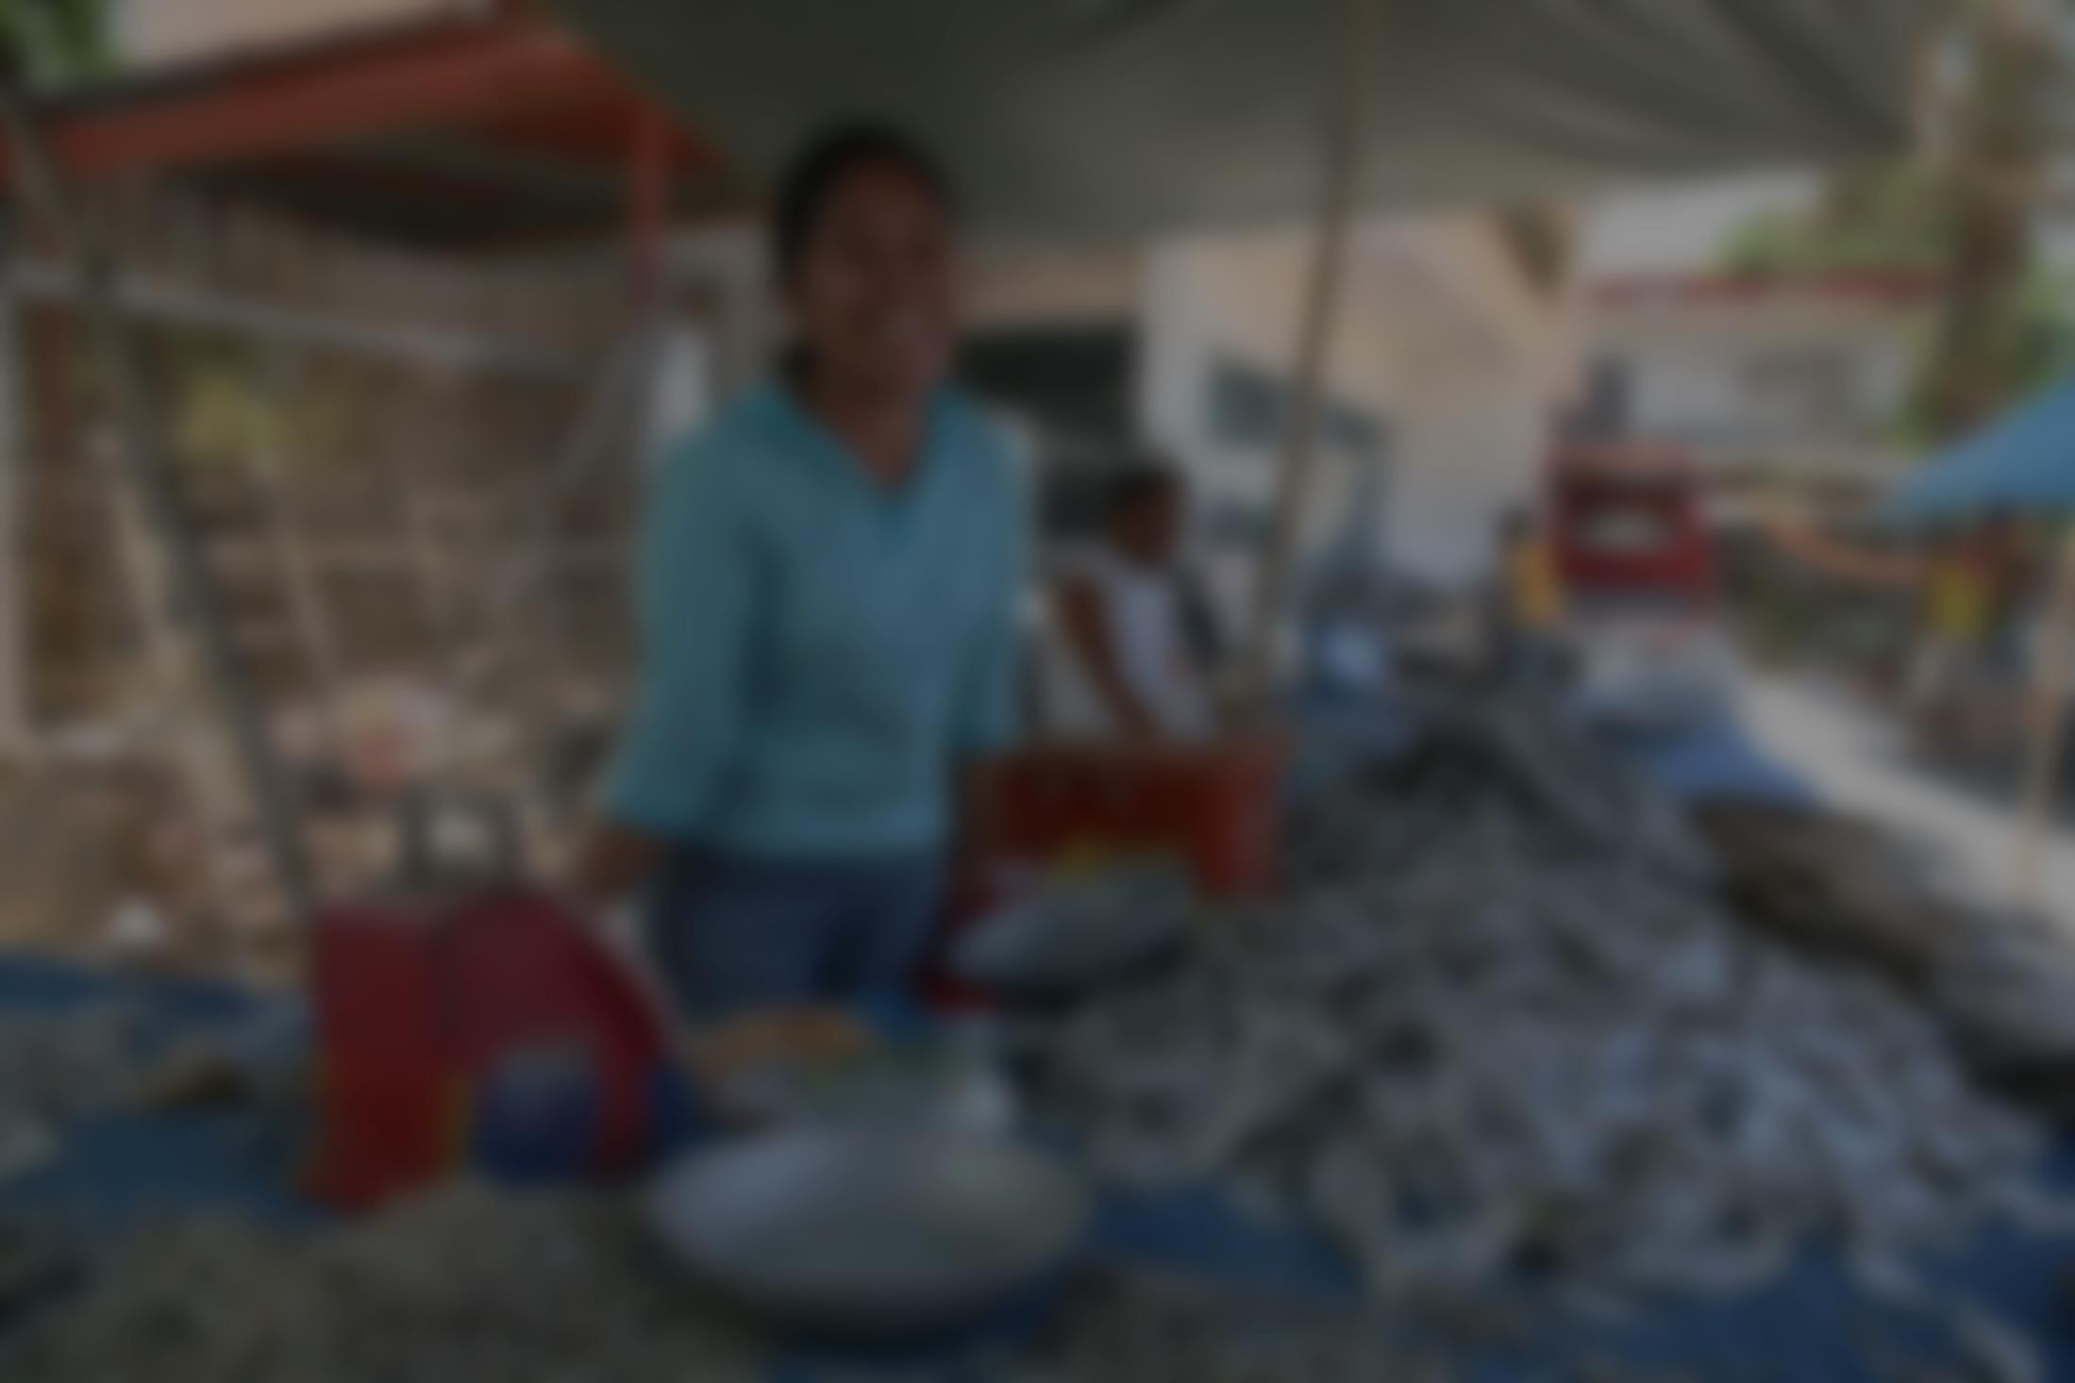
You make a living and earn some money
Help others to do likewise and join the DNN Community team at KIVA.org
Ernst Peter Tamminga
ernst.peter.tamminga@xcess.nl

