Slide 2
Maximize performance for your DNN Installation
Ernst Peter Tamminga
XCESS expertise center b.v. (Netherlands)

Slide 3
Some background
XCESS expertise center b.v.
Using DNN since 2003/V 1.0.x for web applications
DNN Gold Certified Partner
Microsoft Silver partner (25 people, The Netherlands)
XCESS = THE DNN/Evoq experts in The Netherlands
Ernst Peter Tamminga (CEO)
Picked up DNN Events in 2007
Picked up DNN FAQ in 2011
Picked up DNN Reports in 2014
DNN MVP since 2012

Slide 4
Session Objectives
Sharing experiences for improving DNN Performance
Production versus Development
For whom?
Administrators, Hosters, Developers, Skinners
System & Database Administrators (Windows, SQL, IIS)
Your benefit?
Remember at least 2 things you will change
Execute these changes

Slide 5
Session Outline
DNN Technical environment and components
Measuring performance
Improving DNN performance
Host; Admin; Module; Skin
Improving webserver performance
Internet Information Server
Windows server
Improving database server performance
MS SQL server
Windows Server

Slide 6
DNN Technology
DNN
.NET
Windows Server/SQL Server
Internet connection
Client/Browser
Windows Server/IIS
ASP.NET

Slide 7
Why and how?

Slide 8
Measuring website performance
Performance (page, URL)
Technical interpretation: page content = technical optimal
Speed at which webpages are served to the end user
Why spend time on performance?
User Experience
Search Engine Optimization
Measuring performance Offline
Y-Slow (FireFox)
Page Speed for Google Chrome
Measuring performance Online
Google Page Speed Online http://developers.google.com/pagespeed/

Slide 9
Examples

Slide 10
DNNSoftware.com Case Studies
http://www.dnnsoftware.com/community/participate/community-showcase
Please note
Pagespeed does not tell you that a site is wrong.
This is by no means an opinion about the quality of these sites

Slide 11
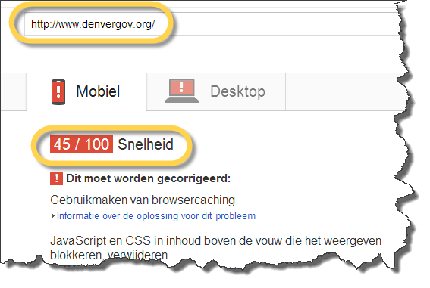
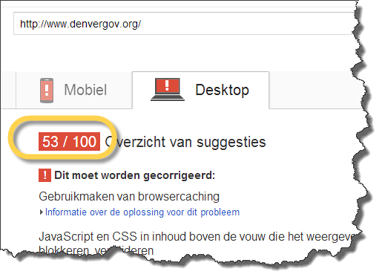
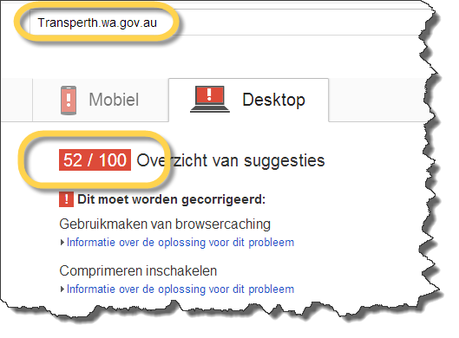
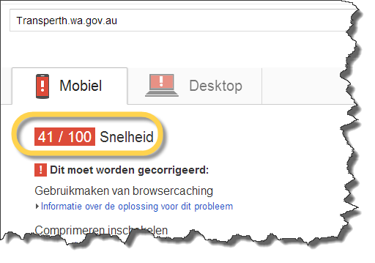
Examples

Slide 12
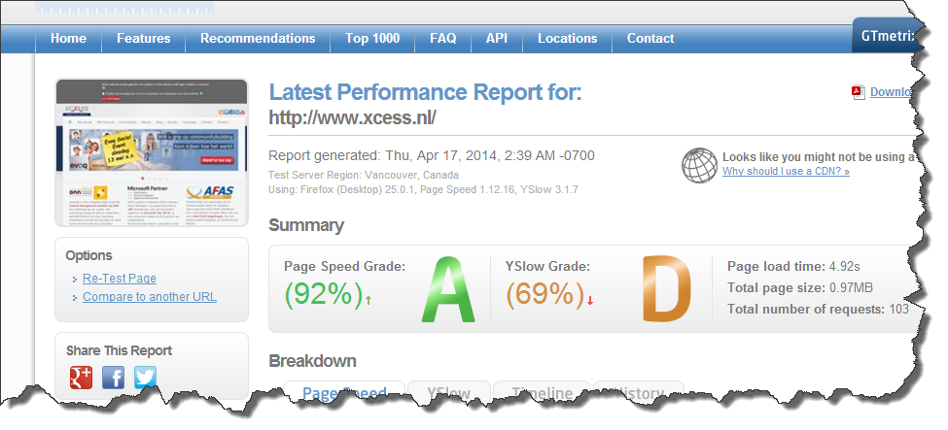
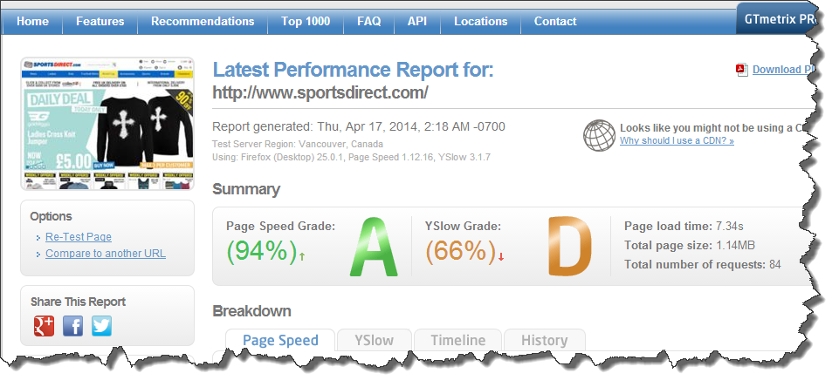
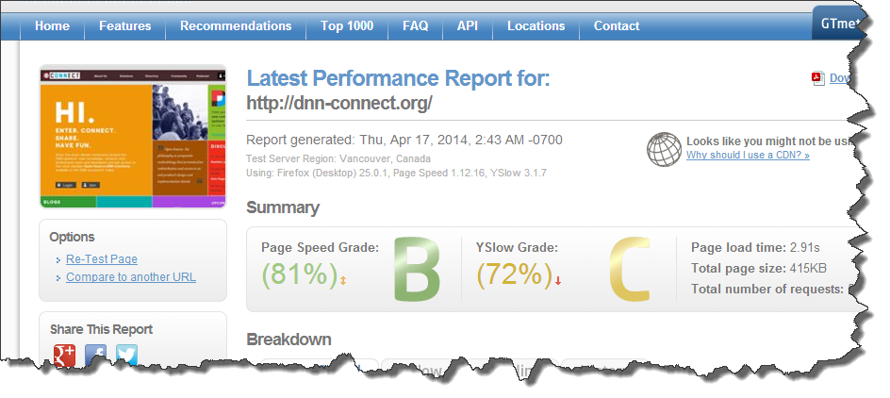
DNN can be (you can do) better

Slide 13
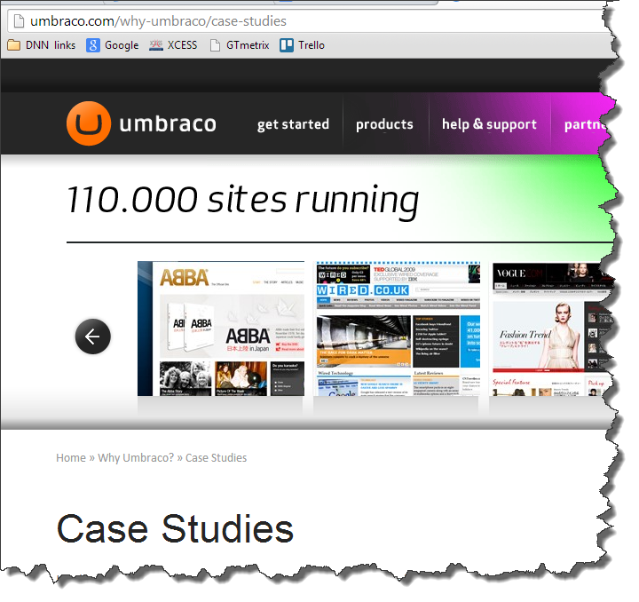
Umbraco

Slide 14
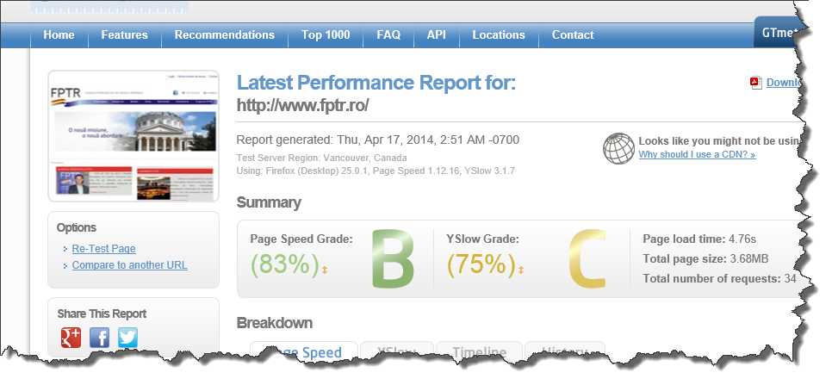
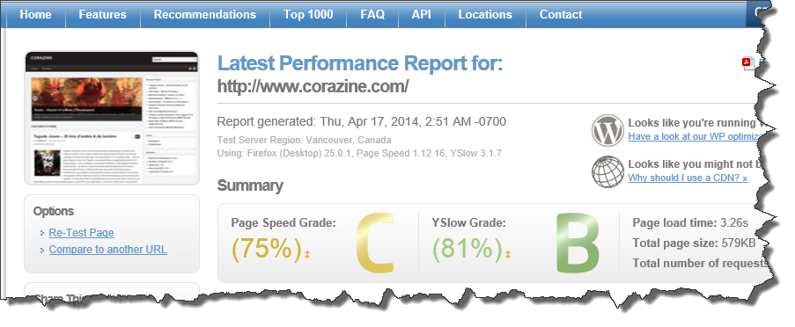
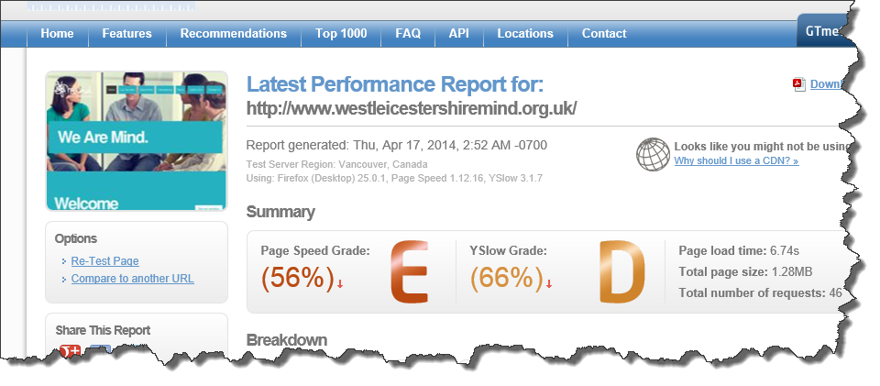
Umbraco samples

Slide 15
Joomla

Slide 16
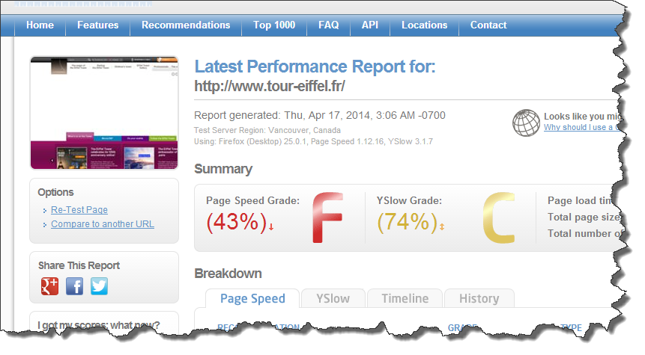
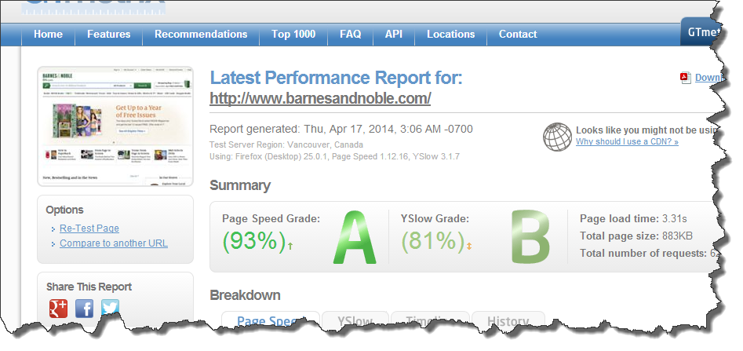
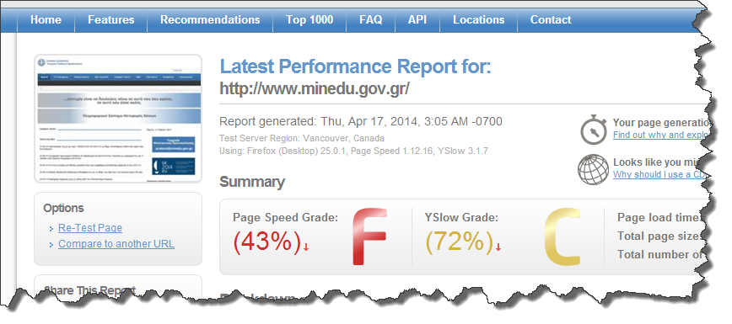
Joomla Examples

Slide 17
WHO?
http://pagespeed.googlelabs.com/

Slide 18
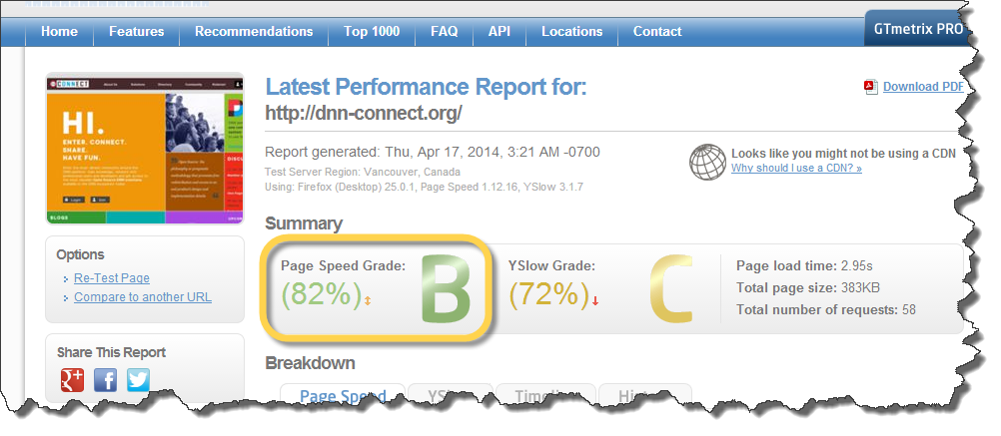
Can WE do better?
→ Yes we can!
Aim at > 80

Slide 19
Host Settings
NOTE
DNN implemented some of the following improvements in 7.2.2

Slide 20
Host level: SETTINGS
Site Log History
Event Log Buffer
Schedule
Auto Sync File system
Caching
jQuery
Client Resource Management
Limit & cleanup
Buffer & cleanup
TimerBased
Off
Memory, heavy
Hosted (be aware)
Activate, load
Demo

Slide 21
Host Level: SCHEDULE
Which schedules needed?
What settings?
Differentiate between
Production: set as needed/desired
Development: all OFF
Demo

Slide 22
How to change Host Level Settings?
Manually
Run SQL script after install
http://dnnperformance.codeplex.com
Change install pack
Install\DNN.install.config

Slide 23
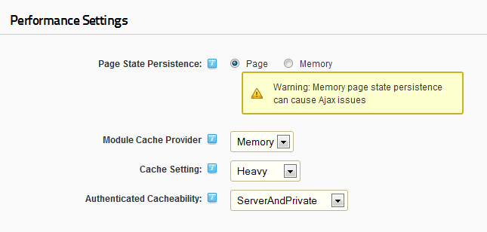
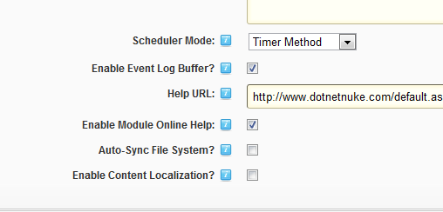
Host Level Settings (after)

Slide 24
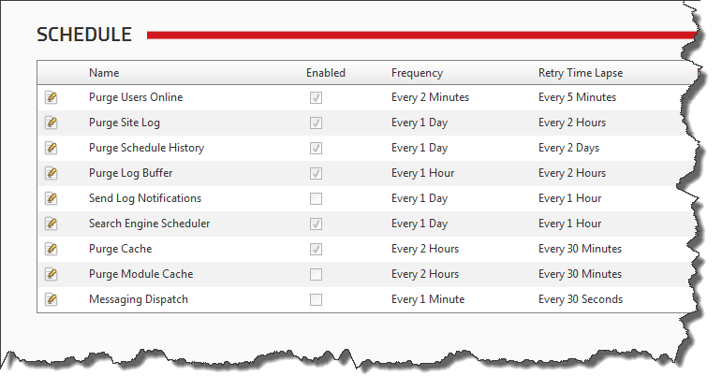
Schedule settings (after)

Slide 25
Host Level Settings

Slide 26
Caching
Default install of DNN has caching set to File Based (pre DNN 7.2.2)
Low server internal memory consumption
Slowest form of available DNN caching

Slide 27
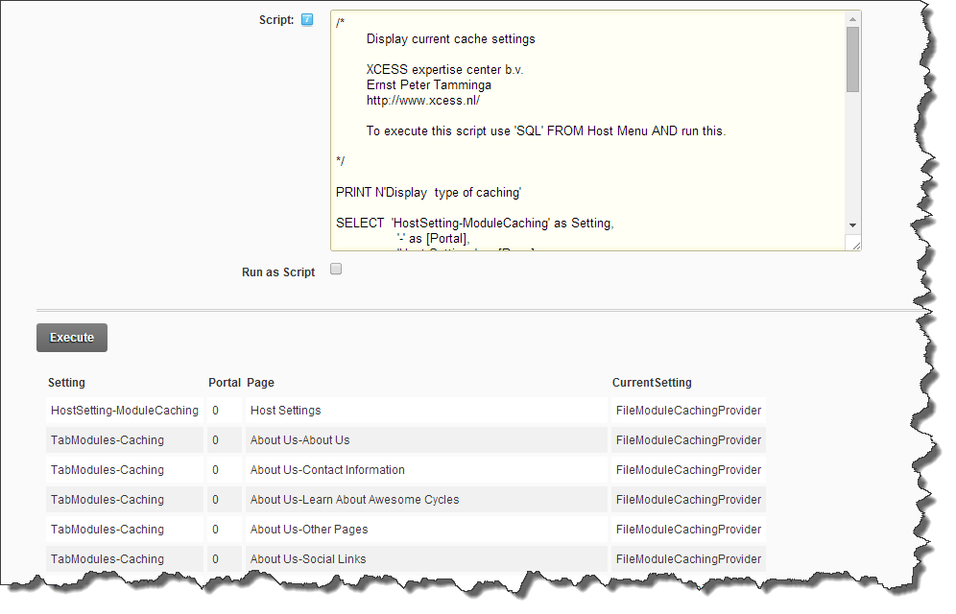
Your current cache settings?
Host SQL → Query available
Demo

Slide 28
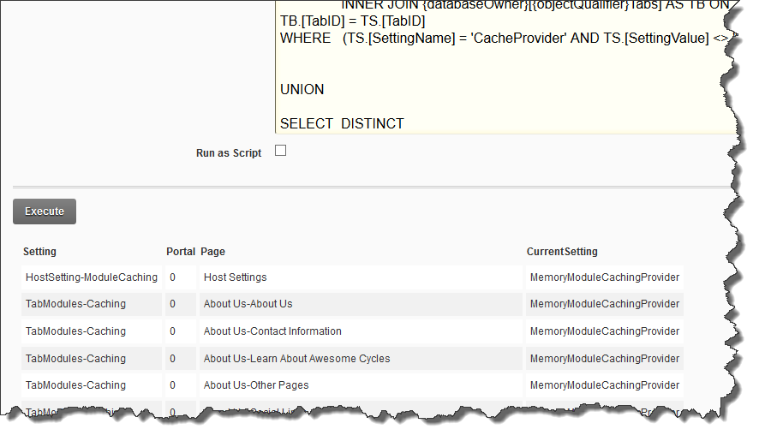
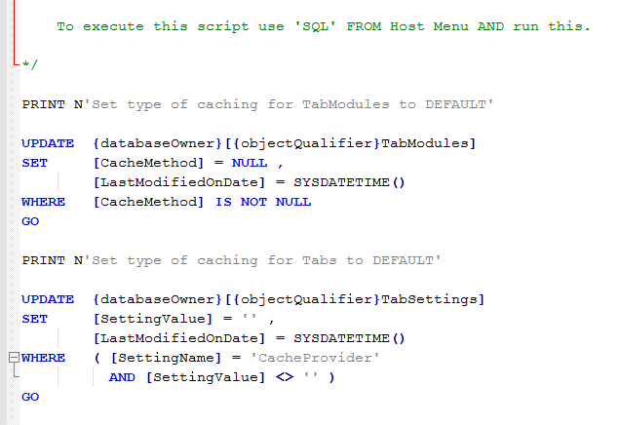
Change to optimal performance?
Host SQL → Query available

Slide 29
The law of conservation of misery

Slide 30
Performance settings: Files
Content Delivery Network
Static files, e.g. images
Folder providers
DNN 6 and up
No demo here
Follow a DNN session with info about folder providers

Slide 31
Performance: Module Development
Image sizing and compression, e.g. OptiPNG
.js compression (minifying), e.g. JSMin
css compression (minifying), e.g. CSSTidy
Automatic minifying in MS Build install package
http://dnntcmsbuild.codeplex.com/

Slide 32
Skin design

Slide 33
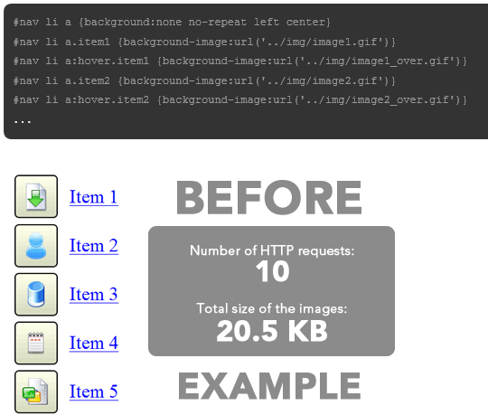
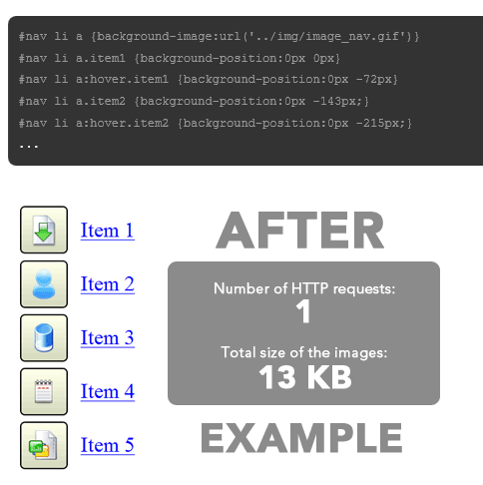
Sprites/images sample
Please note: Using sprites = work
http://css-tricks.com/examples/CSS-Sprites/

Slide 34
Sprites/images sample
Sprites introduction (@CBPSC):
www.youtube.com/watch?v=D4q0p3to9Xo

Slide 35
IIS, ASP.NET

Slide 36
Internet Information Server
Windows Server for IIS
Windows 2008 64bit (R2)
Available memory (at least 4Gb, more = better)
Processor(s) (4 or more)
IIS 7 or higher
Separate application pools
Recycle at an exact time
Ping service
Platform: ping www.yourdomain.com/keepalive.aspx
included in Evoq

Slide 37
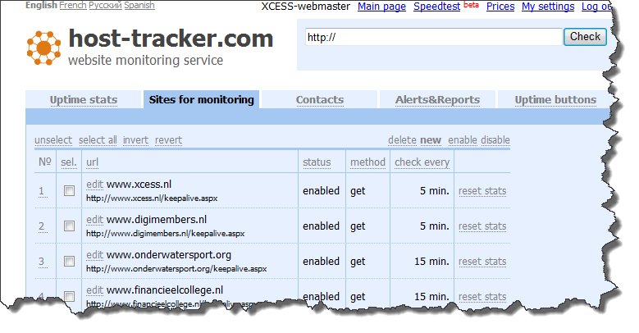
Internet Information Server
Free ping (Keep Alive) services
host-tracker.com
uptimerobot.com
www.statuscake.com

Slide 38
Internet Information Service
Demo
Default Document
Dynamic Compression
Dynamic Content Caching
IIS server
Debug=“false” in web.config
Server in release mode: machine.config
<System.Web>
<deployment retail=true />
</System.Web>

Slide 39
MS SQL Server

Slide 40
MS SQL Server
Windows Server for MS SQL Server
Windows 2008 64bit (R2)
Memory: biggest database *2 + 1Gb (more = better)
SCSI disks 15.000RPm RAID configuration or SSD
SSD for system disk
MS SQL 2008 or higher
No Express versions (No, NEVER!)

Slide 41
TurboSQL (Sebastian Leupold)
TurboSQL is a set of SQL scripts to improve Performance of DNN Platform by optimizing indexes, references, views, functions & stored procedures
http://dnnscript.codeplex.com/
Warning:
Uninstall before upgrading
Check version script vs DNN version

Slide 42
MS SQL Server: server
Do not optimize for ad hoc workloads
Boost SQL priority
CLR execution disabled
SP_CONFIGURE ‘CLR’,0
Compressed back-up
Backup & log to separate volume
Maintenance plans
Daily (backup)
Weekly (backup; check; shrink; re-index; stats, cleanup)
Demo
Notes:
sp_configure 'clr', 0
RECONFIGURE

Slide 43
MS SQL server: database
Recovery model: Simple (if possible)
Auto close OFF
Auto shrink OFF
Log file on separate volume
Grow by size, not by %
Keep some free space, do not shrink often
Log on a separate volume (SSD?)
Demo

Slide 44
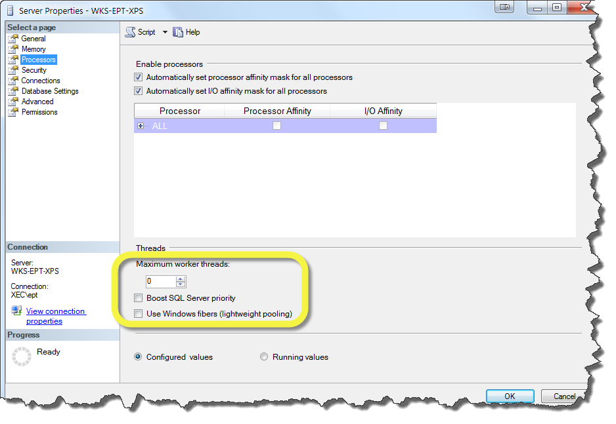
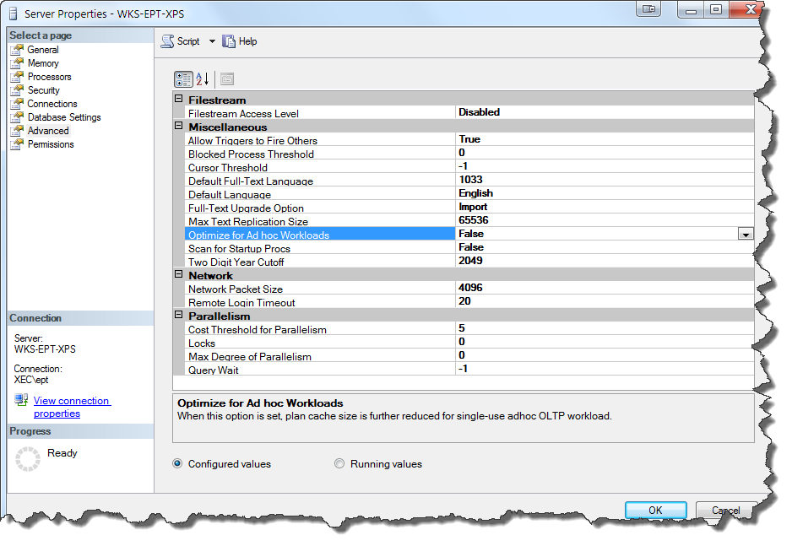
SQL settings
SELECT *
FROM sys.configurations
WHERE name = 'clr enabled'
SP_CONFIGURE ‘CLR’,0
RECONFIGURE

Slide 45
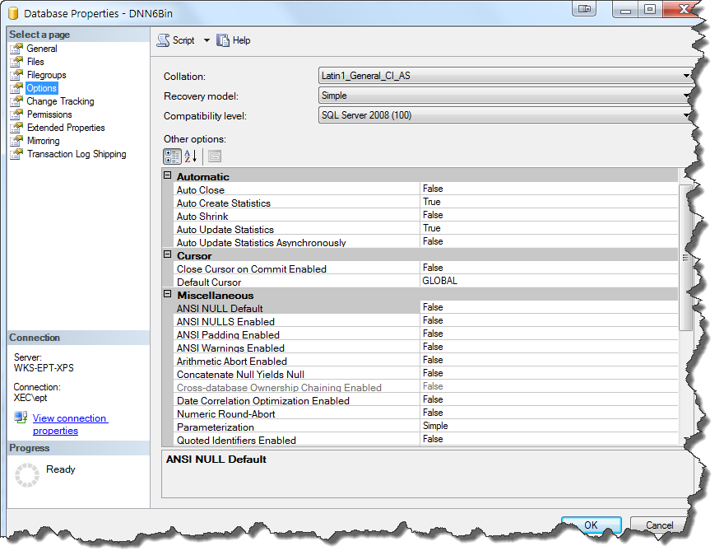
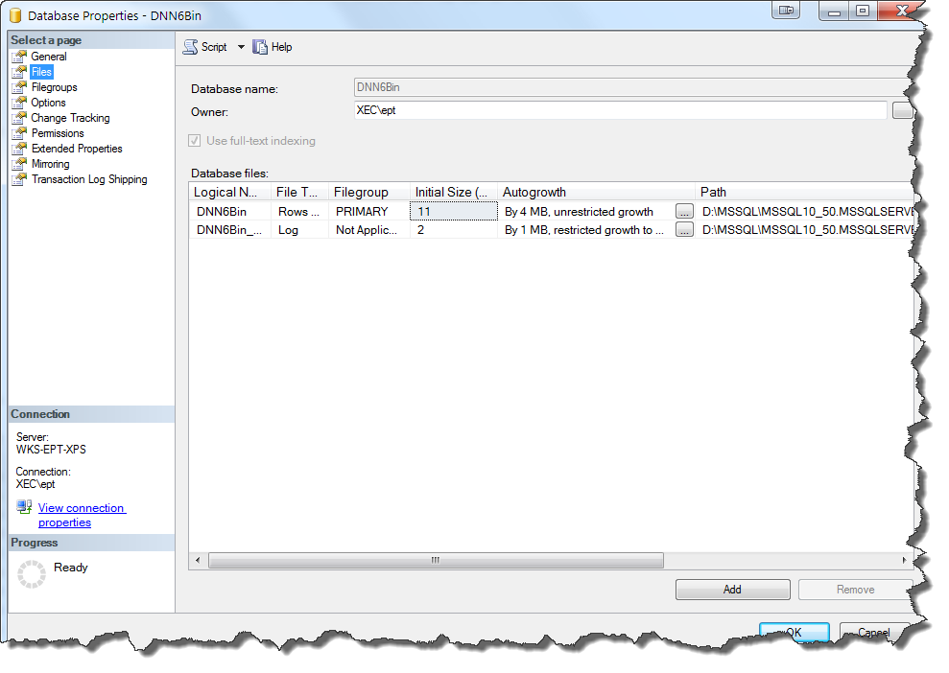
Database options

Slide 46
Troublesome DNN database content
Overflowing Search tables, SiteLog table, Eventlog table
Solution: Test & TRUNCATE when needed
SELECT SCHEMA_NAME(t.schema_id) + '.' + t.name AS TableName ,
p.rows AS RowCounts ,
SUM(a.total_pages) * 8 AS TotalSpace_KB ,
SUM(a.used_pages) * 8 AS UsedSpace_KB ,
( SUM(a.total_pages) - SUM(a.used_pages) ) * 8 AS UnusedSpace_KB
FROM sys.tables t
INNER JOIN sys.indexes i ON t.object_id = i.object_id
INNER JOIN sys.partitions p ON i.object_id = p.object_id
AND i.index_id = p.index_id
INNER JOIN sys.allocation_units a ON p.partition_id = a.container_id
GROUP BY SCHEMA_NAME(t.schema_id) + '.' + t.name ,
p.rows
ORDER BY [TableName]

Slide 47
MS SQL Server
In general: Spend money on Serious Hardware
“There is no substitute for cubic inches”

Slide 48
Hard to find problems
Exceptional conditions for DNN core queries
Example: 1.000 portals, 60 modules/portal, 10 roles per portal, all modules under role security
SQL query Outer Join constructs
Collation sequences
SQL Server setting
Database setting
Table setting
Cross database queries

Slide 49
DNN Technology
DNN
.NET
Windows Server/SQL Server
Internet connection
Client/Browser
Windows Server/IIS
ASP.NET

Slide 50
Performance improvement ALWAYS POSSIBLE
Aim at >80
Remember the 10/90 rule
The Law of Conservation of Misery

Slide 51
Resources
Google Page Speed Online: developers.google.com/pagespeed
YSlow for FireFox: addons.mozilla.org/nl/firefox/addon/yslow
CSSTidy: csstidy.sourceforge.net
JSMin: www.crockford.com/javascript/jsmin.html
SQL Queries for host/admin settings: dnnperformance.codeplex.com
MS Build for DNN: dnntcmsbuild.codeplex.com
Sprites introduction: www.youtube.com/watch?v=D4q0p3to9Xo
YSlow/Pagespeed in one: gtmetrix.com
TurboSQL: https://dnnscript.codeplex.com/
Contact me: ernst.peter.tamminga@xcess.nl

Slide 52
Maximize performance for your DNN Installation
Ernst Peter Tamminga
XCESS expertise center b.v. (Netherlands)

