Slide 2
Presentation SUMMARY
Introduction Eléonore Ungaro
Case Study Gilles Dutertre & Matthieu Lubac (DevPCI)
Hosting DNN Eric Deseez

Slide 3
Altamys
Medium size French company
Working with partners and french community
DNN facing Drupal, Wordpress, Joomla…
An Open Source Microsoft solution ? it exists?
Business development with DNN in France
Awareness
DNN promotion
Microsoft Partner
TD 2014 Event
The Story telling
What about
DNN
awareness
in your country ?

Slide 4
Case STUDY
Gilles DUTERTRE
Matthieu LUBAC

Slide 5
Who ?
Professional federation
About 450 members
Daily support on social, economical and legal informations
What ?
Sends twice a month a newsletter with a lot of documents
Costs a lot
Not « Eco-friendly »
Takes time to prepare
How ?
Website and electronic newsletter
Same organisation
New design
Ease of use
Partnership with Gilles le Pigocher and DEVPCI

Slide 6
Work with DNN French Community
DEVPCI
Project Management, Integration & development
Gilles Le Pigocher
DNN MVP
Development of the Wizard
Integrating
OnyakTech
Mailjet

Slide 7
Deal with…
Usable for people without any skills in DNN or anything related to HTML.
Make it easy to use it in a very short time.
Integrated with existing custom modules (News & Schedule module type).
Contents must be part of other module’s data.
Check Outlook compatibility .
Not enough time to develop it all from scratch.

Slide 8
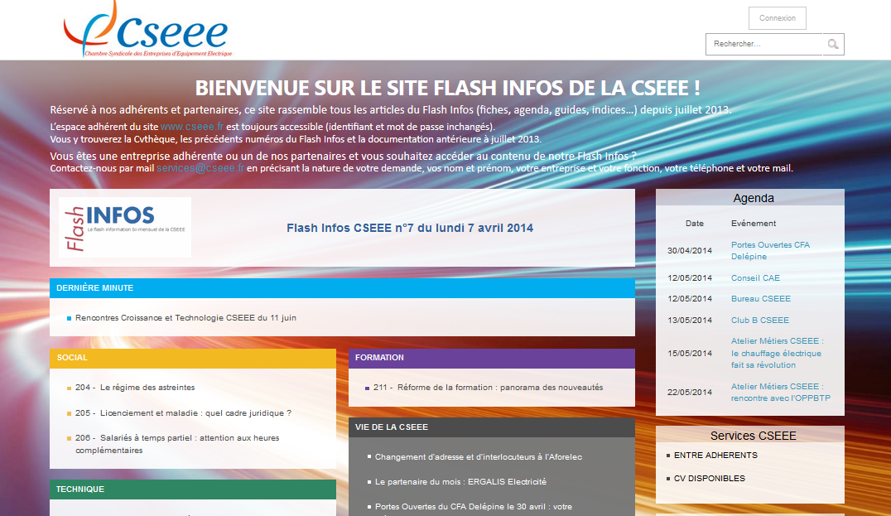
Our approach…
Usability: We have create a wizzard module for a step by step process to realize a new campaign. Easy and effective.
Keep it flexible: No modification of the DNN Source code. No modification of the third modules in use. The Body of the Newsletter is create from a template (with Tokens).
Get in time: We have install a Axon Module (from Onyack Tech) and we have use it for the trackin system links and the send method.
Articles available online
Home is refreshed with the newsletter
Custom module to easily prepare the newsletter

Slide 10
« The person in charge of the newsletter was concerned about the solution being to complicated : DNN met all her requirements and after one day of training she can now use it very simply »
« Today, the most difficult thing is to write the content. Once done, it only takes a few clicks to gather all the information and to send the newsletter»

Slide 11
Hosting DNN
our vision
Eric DESEEZ

Slide 12
Altamys
HOSTING SOLUTION
EVOLUTION 1
Mixed mode
Equinix
Azure
EVOLUTION 2
Hybrid 1
Hosting in Equinix modification
Windows Azure Pack
Full management like Azure
Azure dev -> Equinix prod
ACTUALLY
Hosting at Equinix
Notes:
Actually 4 serveurs windows serveur 2012 and SQL Serveur 2012
The First evolution:
Windows Serveur 2012 R2
SQL Server 2012 and then 2014
Azure and DNN
Web Sites
Web + SQL
Direct from Azure Library
Virtual Machine

Slide 13
Altamys
HOSTING EVOLUTION
suite
EVOLUTION 3
Hybrid 2
Hosting in Azure or Equinix
Windows Azure Pack
Full management like Azure
Azure Expressroute
High availability hosting

Slide 14
Windows Azure Pack - Services for On-premise Clouds
Windows Azure
Customer
Service Provider
Web Sites
Apps
Database
VMs
Service
Plans
Users
Web Sites
Apps
Database
VMs
Subscriber Self-Service Portal
Self Service Portal Moves On-Premises
Provider Portal
Consumer Self-Service Portal
Service Management API
Common Mgt. Experience
Service Management API
Future Services
Worker
Role
Web
Sites
VM
Role
SQL
Service
Bus
Caching
Other
Services
CDN.
Media,, etc.
Cloud-Enabled Services Move On-Premises
Web
Sites
VMs
SQL
Service
Bus
R2 w/ Service Provider Foundation
Workloads
Consistent Dev. Experience

Slide 15
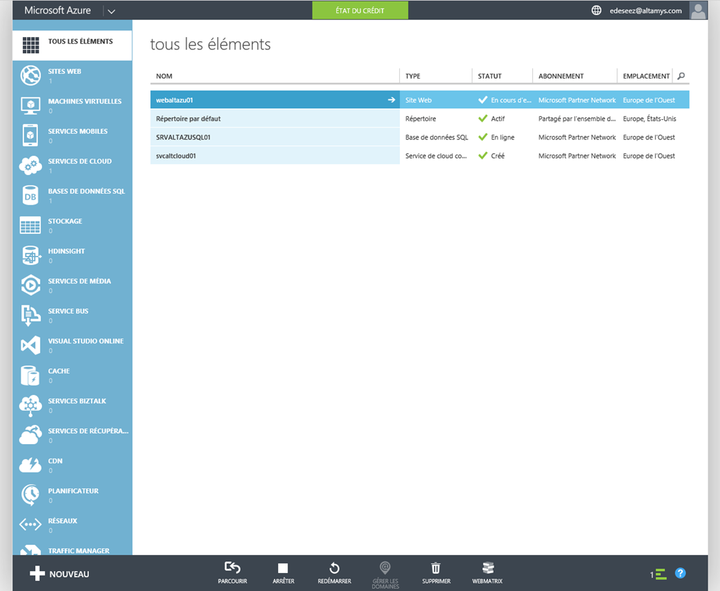
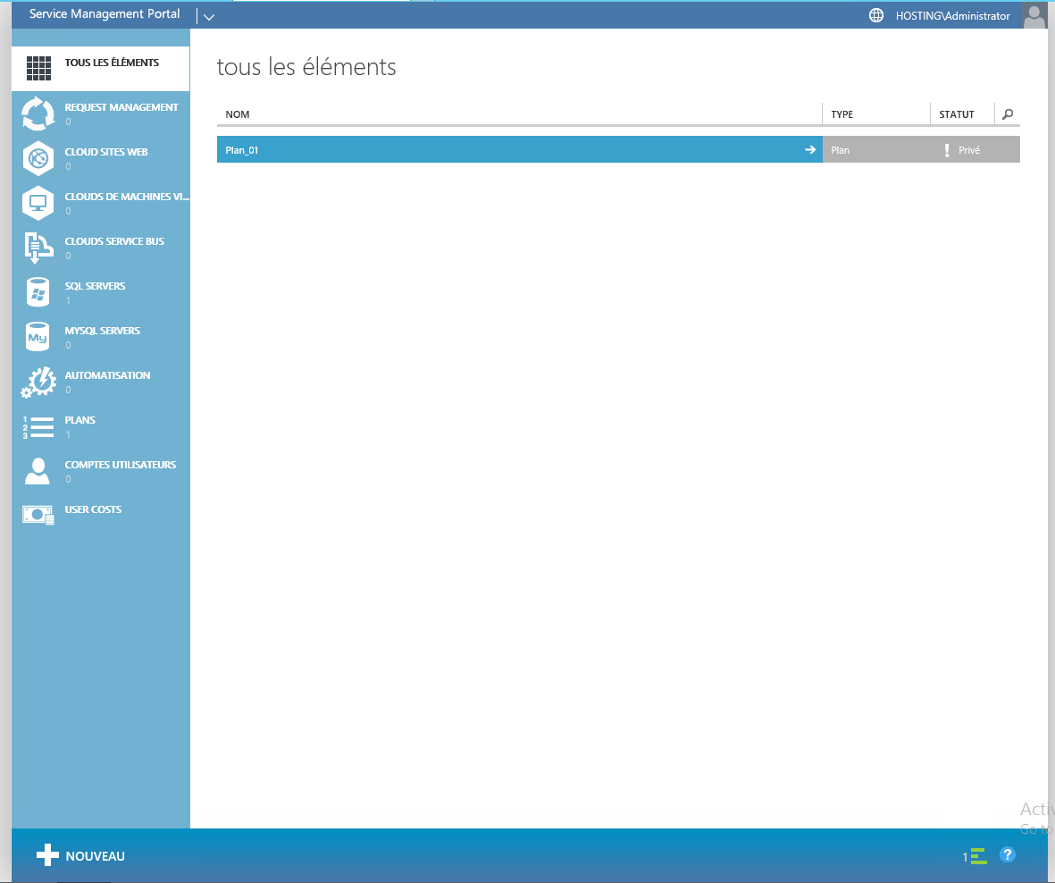
Azure vs Windows Azure Pack

Slide 16
GRAZIE per l’attenzione

