Slide 1
Improve Performance
Responsive Images
James Rosewell

Slide 2
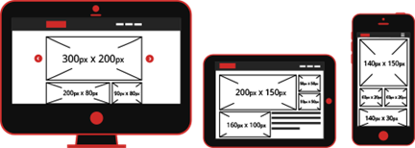

Slide 3
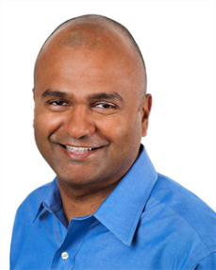
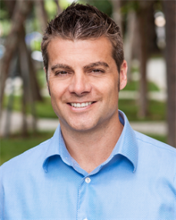
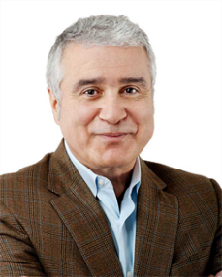
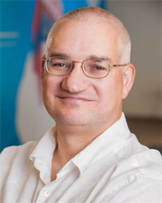
Magnificent Seven

Slide 4
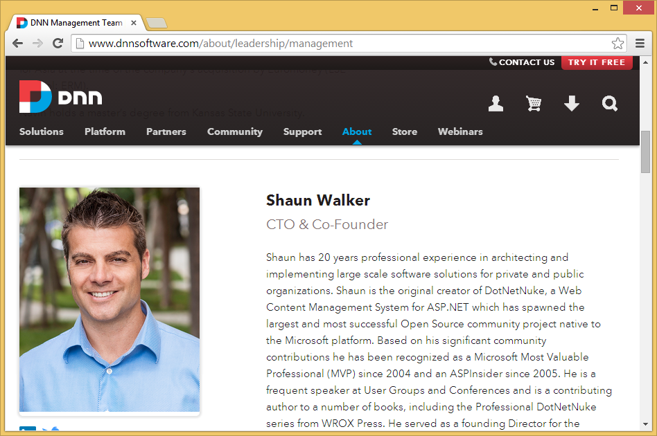

Slide 5
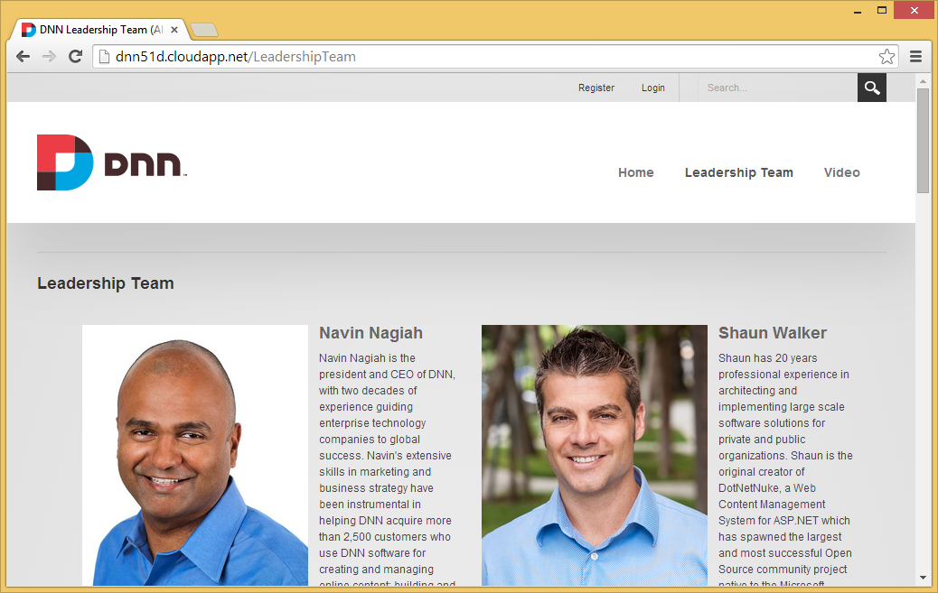

Slide 6
Guess the weight of the Magnificent Seven?

Slide 7
Magnificent Seven
2.4mb

Slide 8
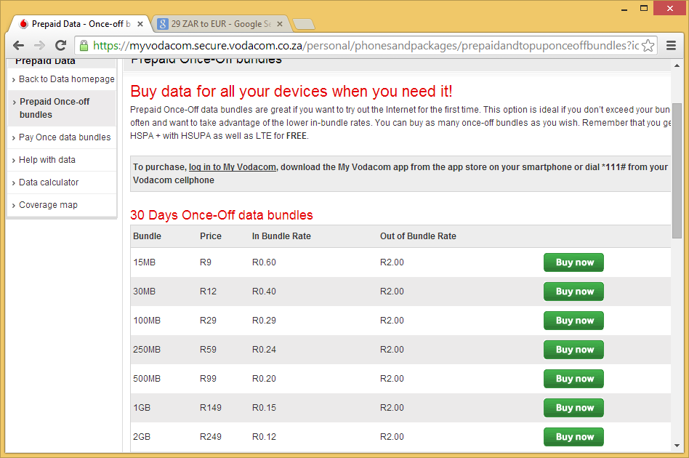

Slide 9
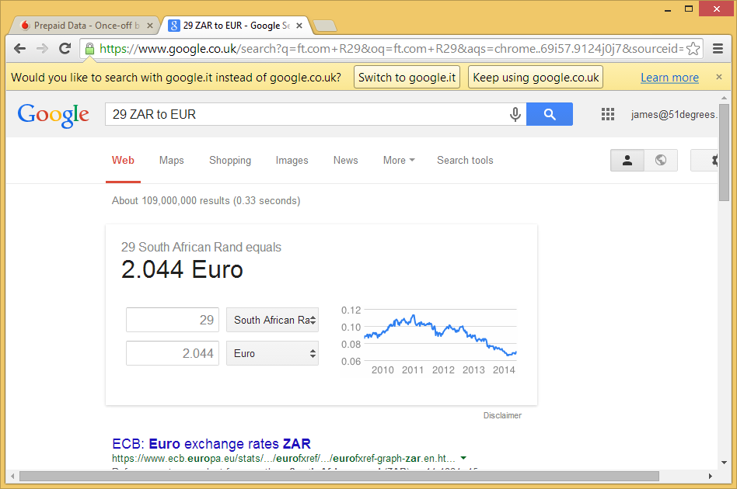

Slide 10
€0.10 - €0.05

Slide 11
Responsive Images

Slide 12
Configure DNN 7.3
web.config
51degrees.[mobi].config

Slide 13
web.config
<add name="Detector" type="FiftyOne.Foundation.Mobile.Detection.DetectorModule, FiftyOne.Foundation" preCondition="managedHandler" />
…becomes…
<add name="Detector" type="FiftyOne.Foundation.Mobile.Detection.DetectorModule, FiftyOne.Foundation" />
Enables the module to intercept requests for images

Slide 14
51Degrees.config
<detection enabled="true" binaryFilePath="~/App_Data/51Degrees-LiteV3.dat" />

Slide 15
51Degrees.config
<imageOptimisation
maxWidth="1000"
maxHeight="1000”
widthParam="width"
heightParam="height“
factor="1" />
Controls possible permutations of generated images

Slide 16
PART One
Fixed Size Images

Slide 17
250px

Slide 18
Image URLs
<img alt="Shaun Walker" src="/portals/0/images/Leaders/shaun_walker.png" />
…becomes…
<img alt="Shaun Walker" src="/portals/0/images/Leaders/shaun_walker.png?width=250" />

Slide 19
Reduction
 | Base | Fixed Size
Page Weight | 2.4mb | 1.5mb
HTTP Requests | 35 | 35
Reduction | - | 0.9mb
Method | - | ?width=x

Slide 20
But what about responsive web design? We don’t know the size.

Slide 21
PART TWO
Automatic Images

Slide 22
Image URLs
<img alt="Shaun Walker" src="/portals/0/images/Leaders/shaun_walker.png" />
…becomes…
<img alt="Shaun Walker" src="/portals/0/Empty.gif" data-src="/portals/0/images/Leaders/shaun_walker.png?width=auto" />

Slide 23
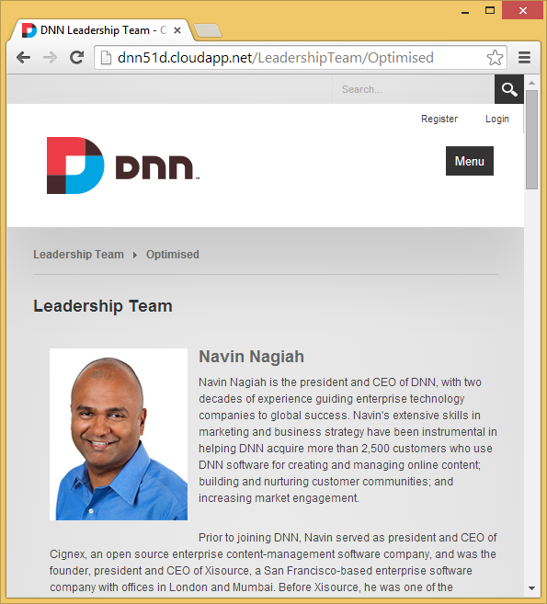

Slide 24
Reductions
 | Base | Partial | Automatic
Page Weight | 2.4mb | 1.5mb | 811kb
HTTP Requests | 35 | 35 | 36
Reduction | - | 0.9mb | 1.6mb
Method | - | ?width=x | ?width=auto

Slide 25
Magnificent Seven
From 2.4mb to < 1mb

Slide 26
Benefits
Significant saving. Important for mobile.
Saves radio. Golden second.
Saves battery. Less CPU.
Very easy to deploy and saves time.

Slide 27
Questions
Impact on the server?
Images are cached and tracked.
Open to abuse?
Image optimisation element limits permutations.
Will it work with CDNs?
Yes where dynamic images provided.
Client impact?
Simple client side JavaScript. No jQuery.
When will be available?
DNN 7.3 – not enabled by default.
What image formats are supported?
PNG and JPG at the moment.

Slide 28
Questions – Version 1.1
Does it work with Azure / CDN storage?
Maybe and not yet!
Does it support cropping?
Not yet.
What about retina displays?
Some issues with pixels densities. Probable upgrade.

Slide 29
display:none

Slide 30
Your Feedback

Slide 31
Dynamic Containers
Server Side
James Rosewell

Slide 32
Web Pages Vary by…
Screen size
User attributes (beyond role)
Examples include:
Adverts
Videos
Business Processes

Slide 33
How to display / remove containers based on server side rules?

Slide 34
What we need
Skin that can change view
Containers that respond to active view

Slide 35
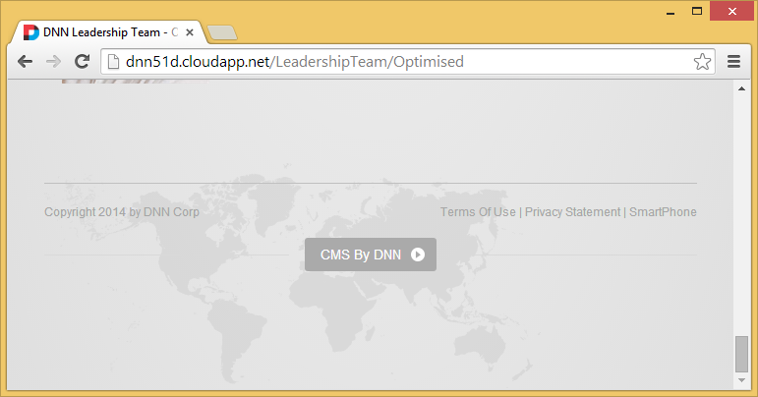
skin_controller.ascx

Slide 36
How to default the view?

Slide 37
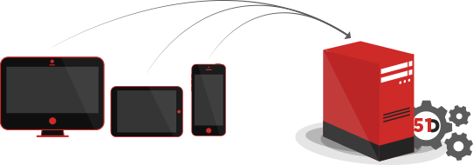

Slide 38
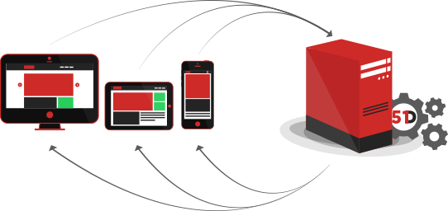

Slide 39
skin_controller.ascx
public string CurrentView
{
get
{
var value = Request.QueryString["ViewType"];
if (value == null)
{
value = Session["ViewType"] as string;
}

Slide 40
skin_controller.ascx
if (value == null)
{
if (Request.Browser["IsSmartPhone"] == "True" ||
Request.Browser["IsSmallScreen"] == "True")
{
value = "smartphone";
}
else
{
value = "desktop";
}
}

Slide 41
skin_controller.ascx
Session["ViewType"] = value;
return value;
}
}

Slide 42
Title_h2 - Desktop Only.ascx
<script runat="server">
protected override void OnLoad(EventArgs e)
{
base.OnLoad(e);
Visible = FiftyOneController.CurrentView == "desktop"
|| FiftyOneController.IsEditMode;
PanelEditWarning.Visible = FiftyOneController.IsEditMode;
}
</script>

Slide 43
Title_h2 – Mobile Only.ascx
<script runat="server">
protected override void OnLoad(EventArgs e)
{
base.OnLoad(e);
Visible = FiftyOneController.CurrentView == "smartphone" || FiftyOneController.IsEditMode;
PanelEditWarning.Visible = FiftyOneController.IsEditMode;
}
</script>

Slide 44
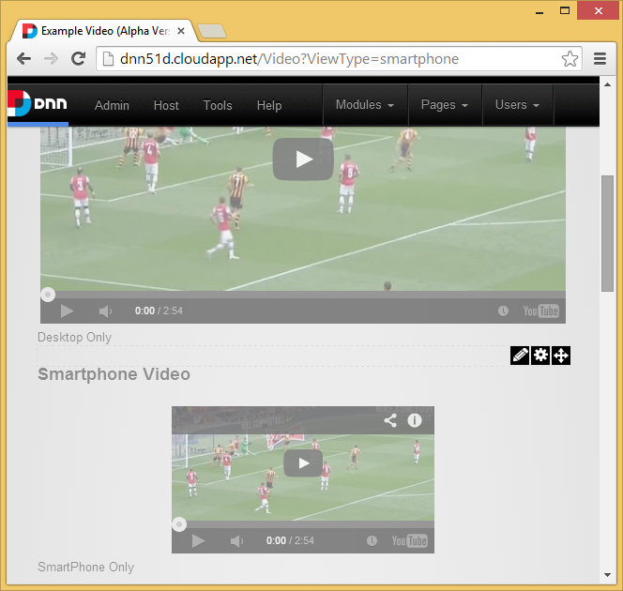

Slide 45
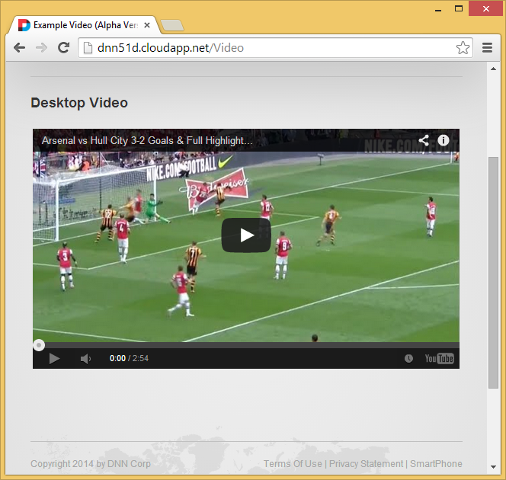

Slide 46
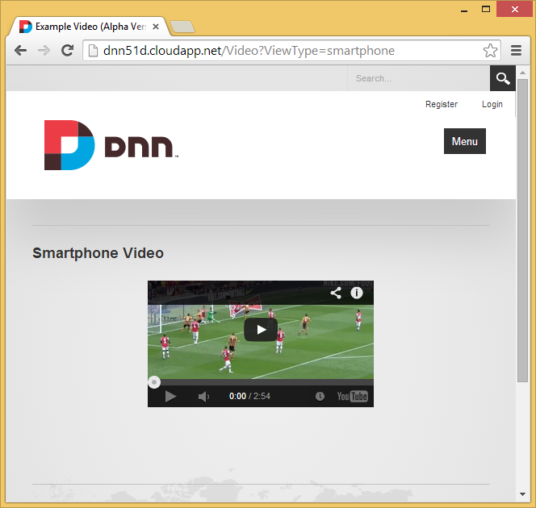

Slide 47
Next Steps
Add A/B testing for screen sizes for adverts.
More categories of device.
However…
Display rules based on container name are too simple, need rules engine.

Slide 48
DNN Sharp – My Tokens & Easy Container

Slide 49
Thank you to Graham Murkett – Some Grey Bloke

Slide 50
Device FRAGMENTATION

Slide 52
Other Important Factors
Device Capabilities
Network Conditions

Slide 53
Device detection

Slide 54
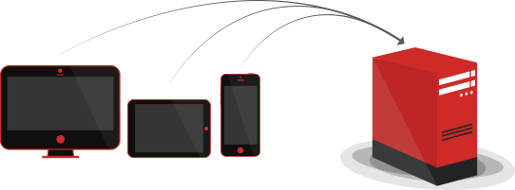

Slide 57
WHO USES 51Degrees?

Slide 58
1.5 Million Web Sites. Including…

